Slide 1
Install Docker on Linux Machine

Slide 2
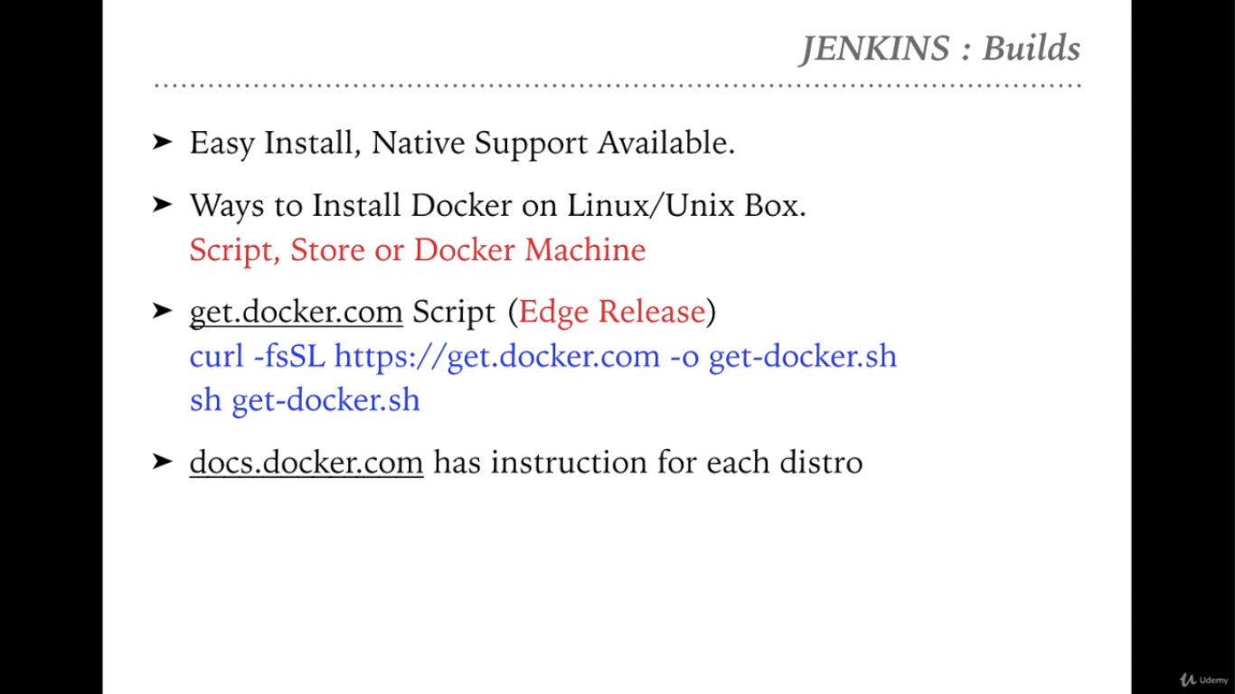

Slide 3
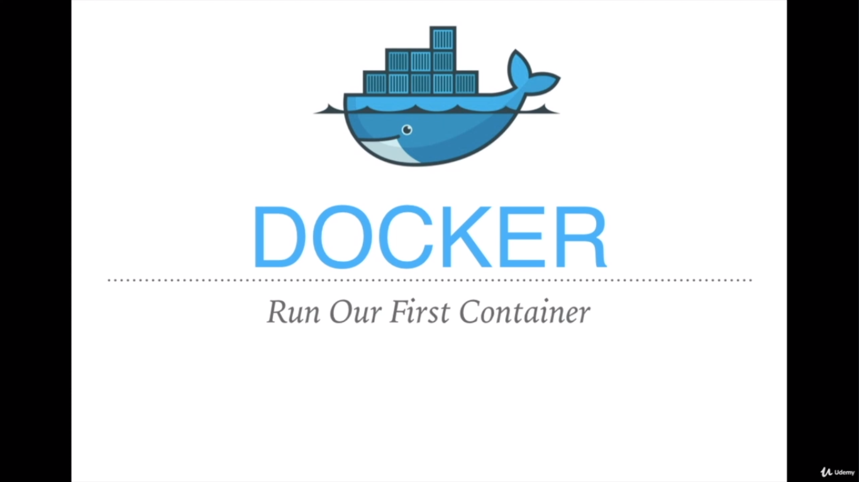

Slide 4
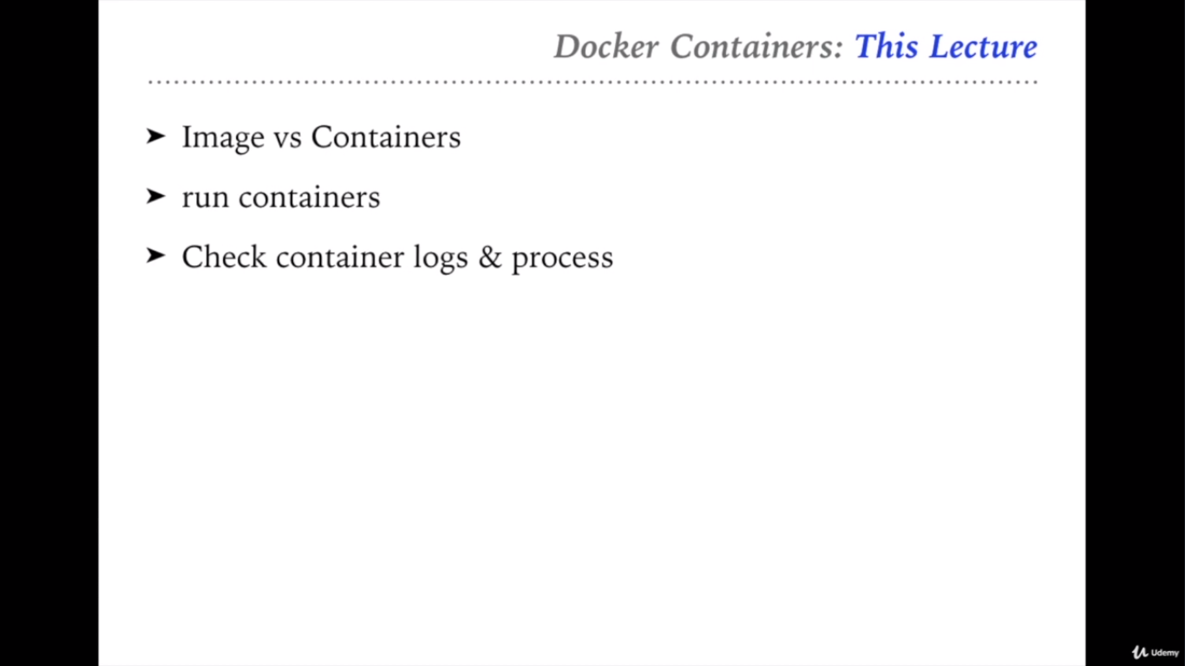

Slide 5
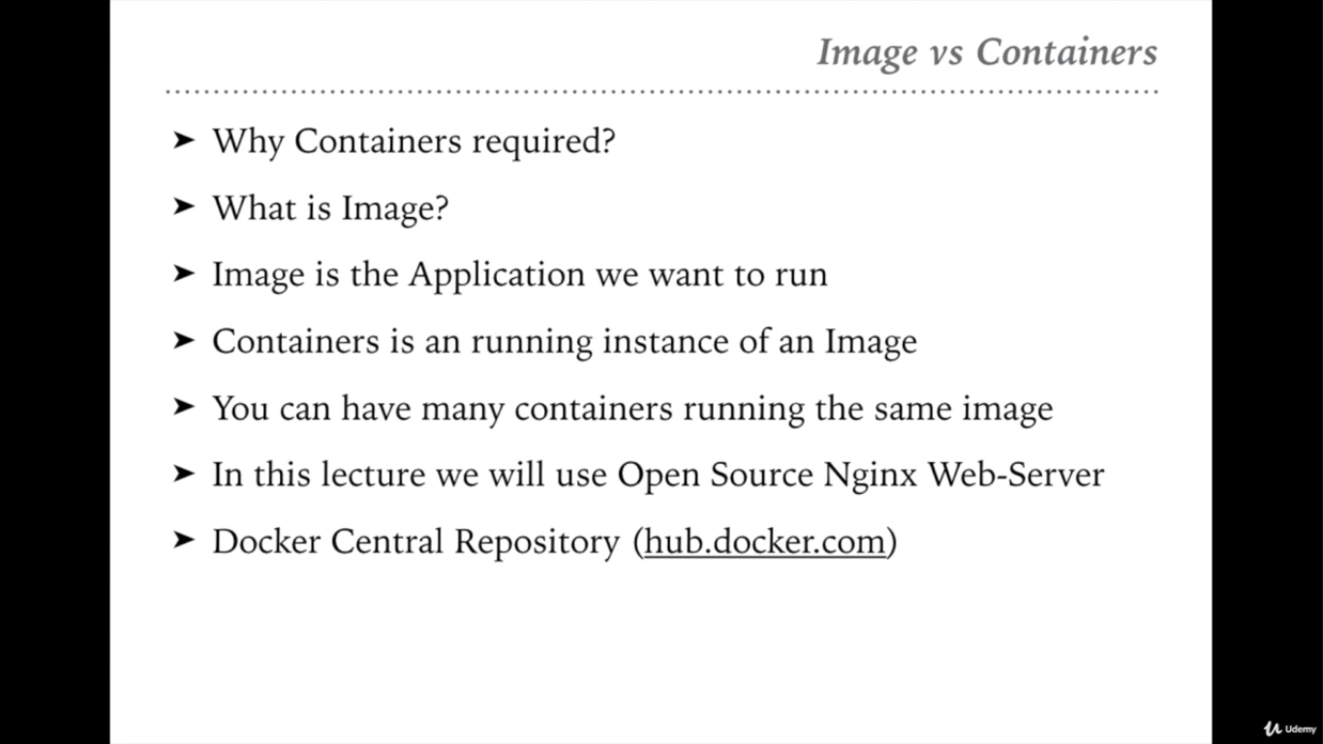

Slide 6
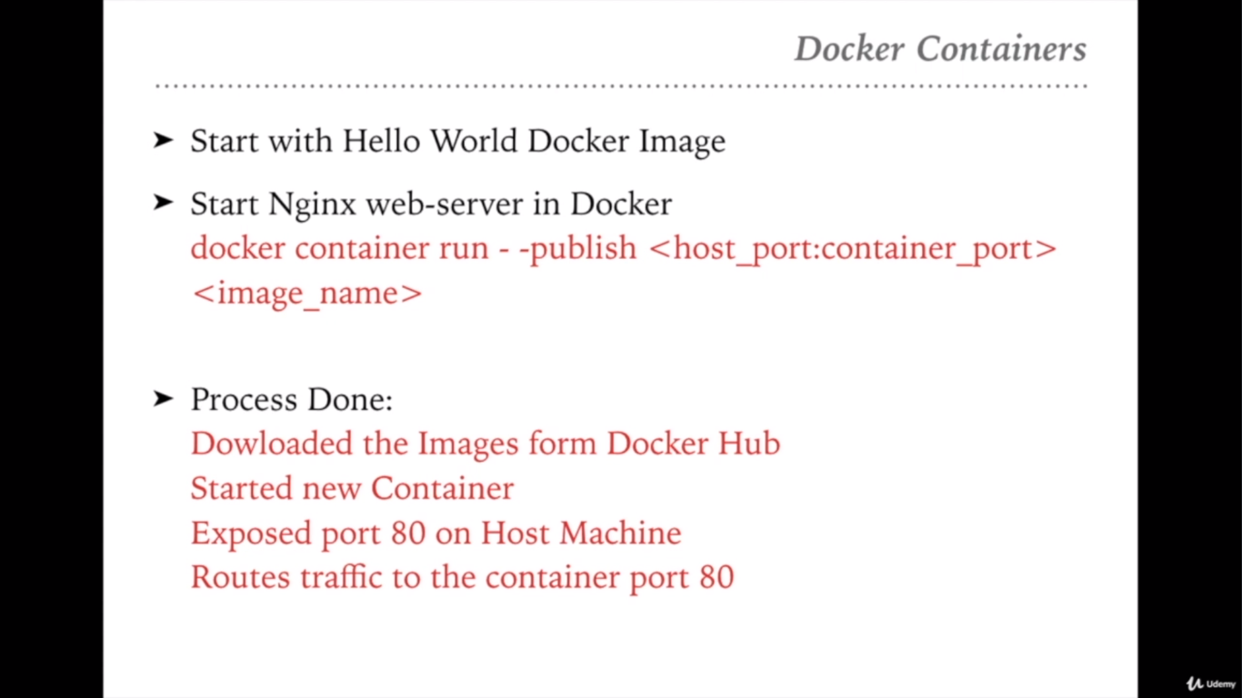

Slide 7
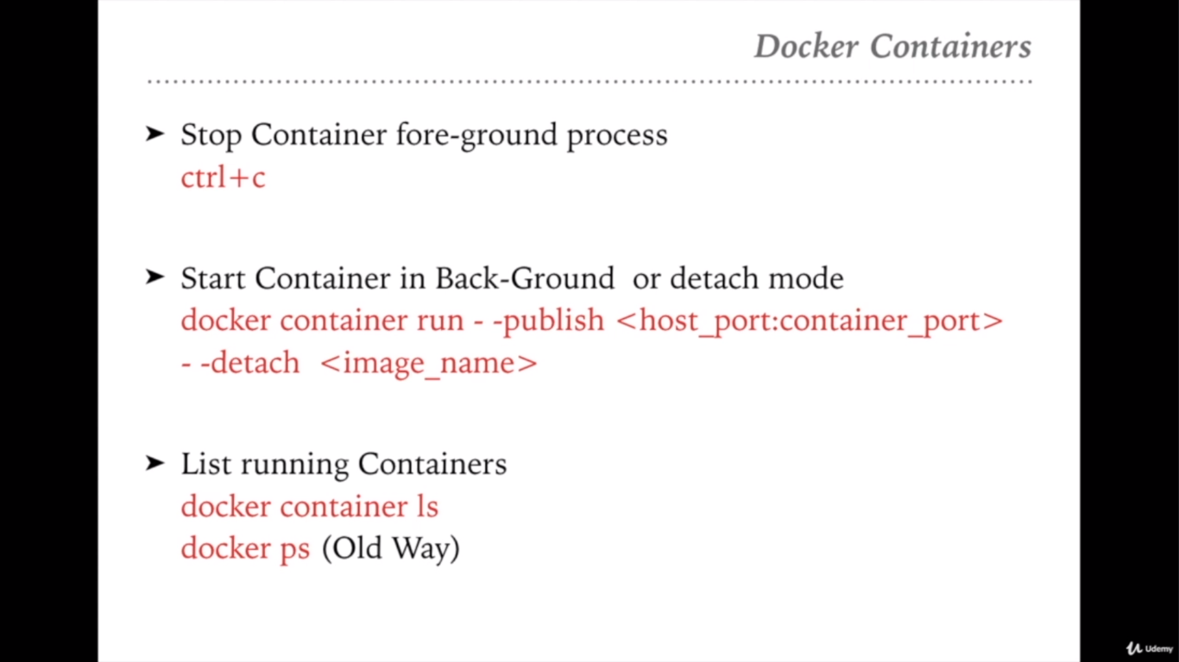

Slide 8
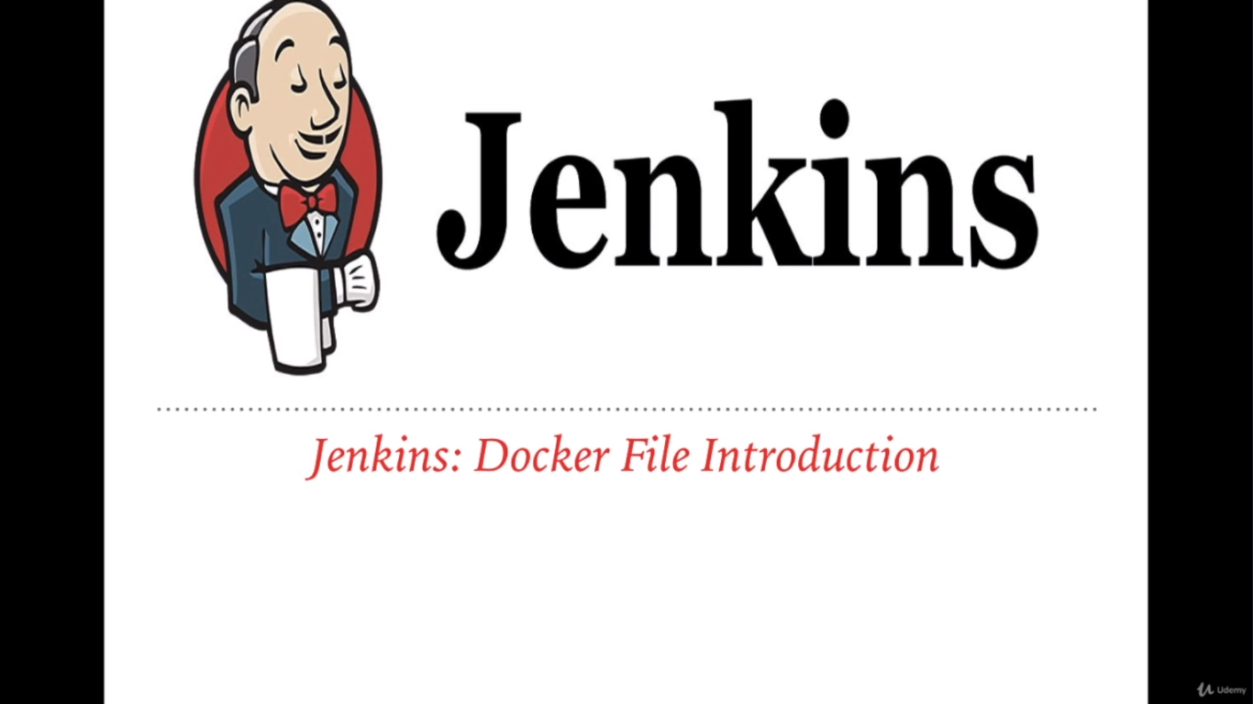

Slide 9
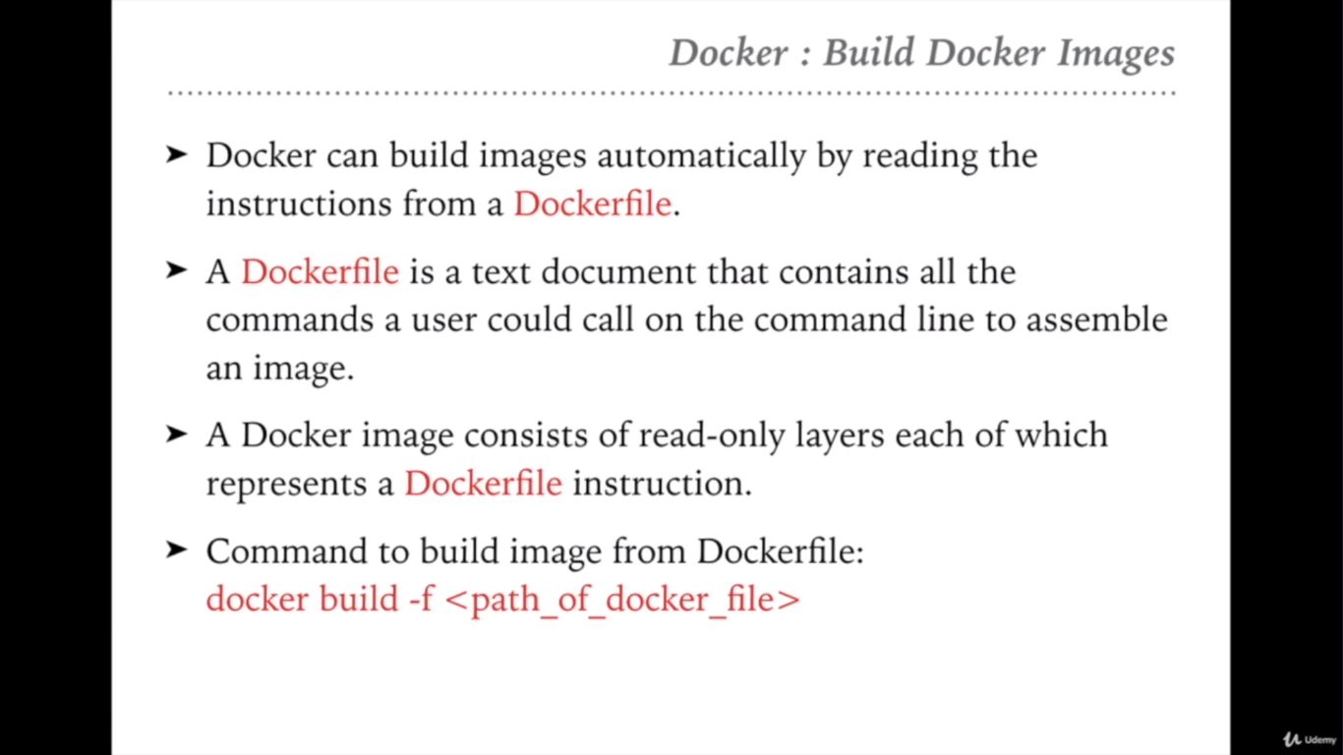

Slide 10
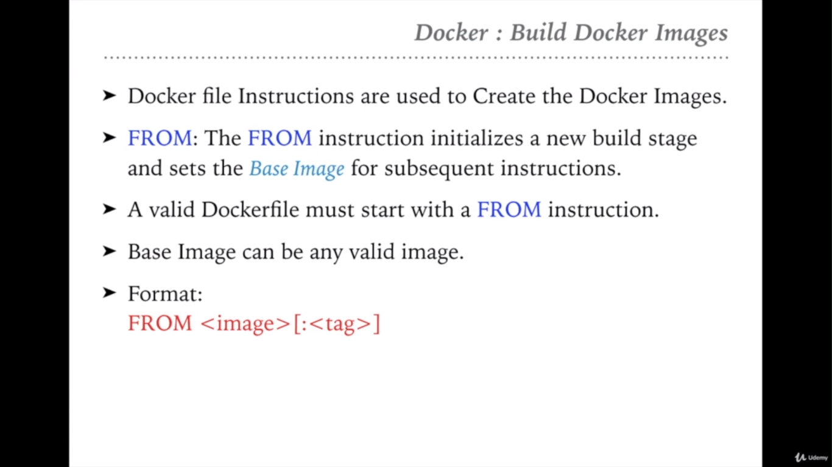

Slide 11
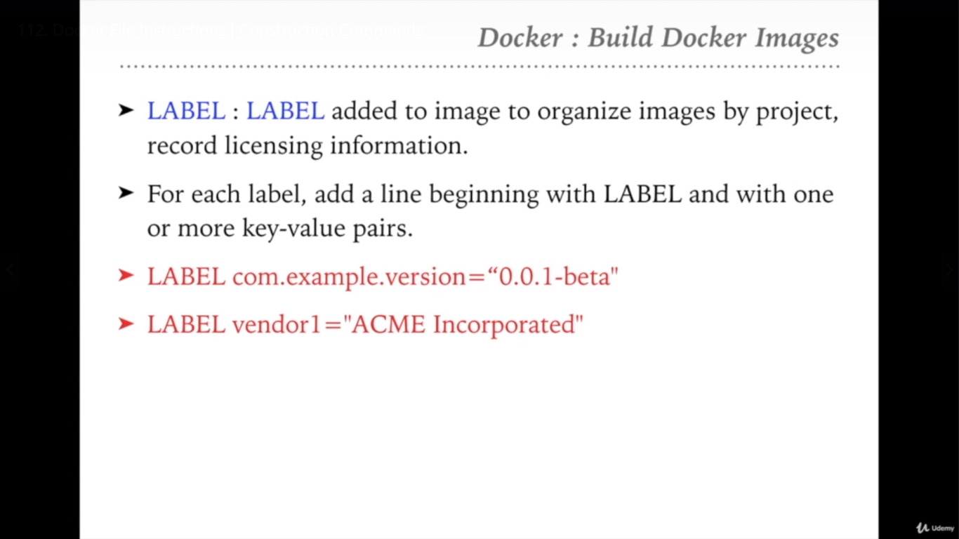

Slide 12
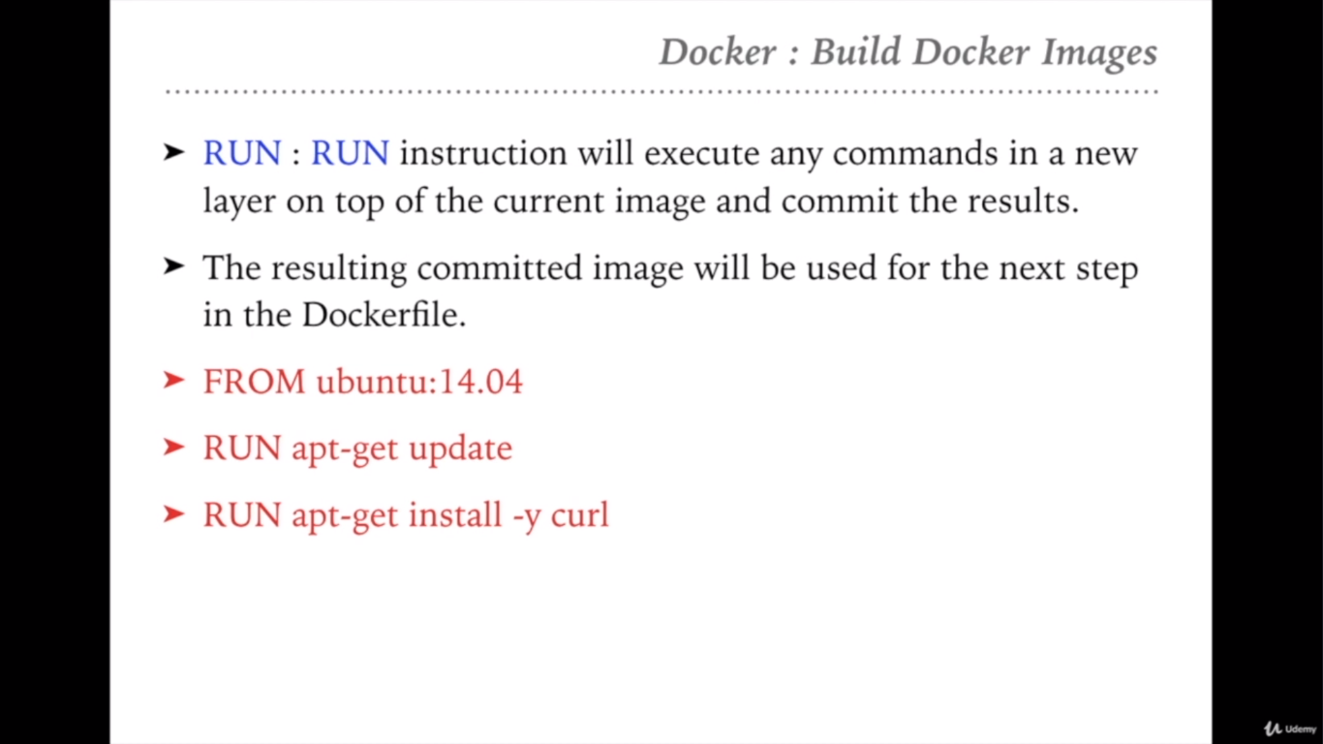

Slide 13
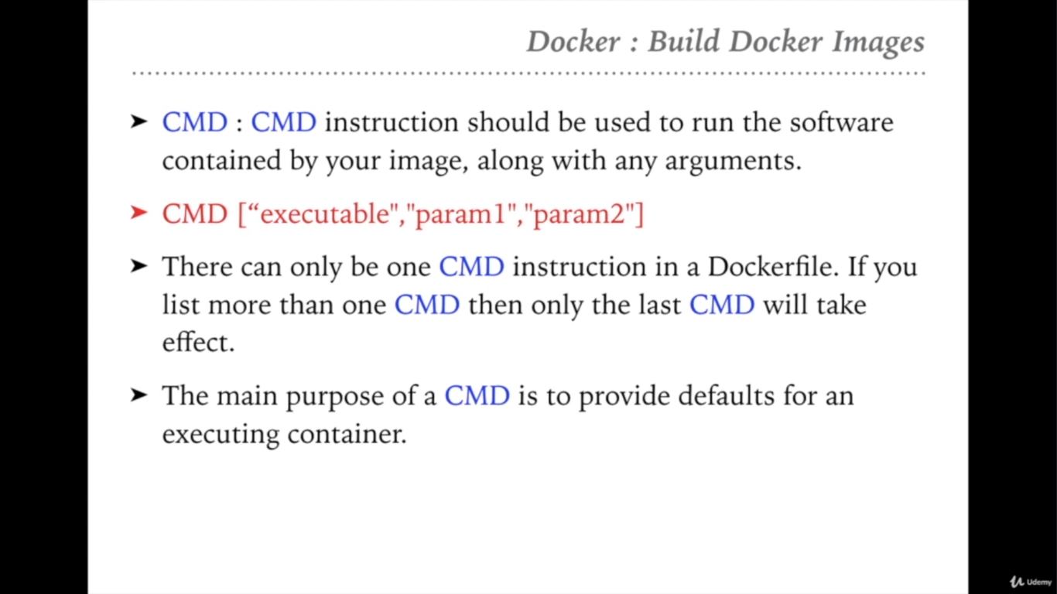

Slide 14
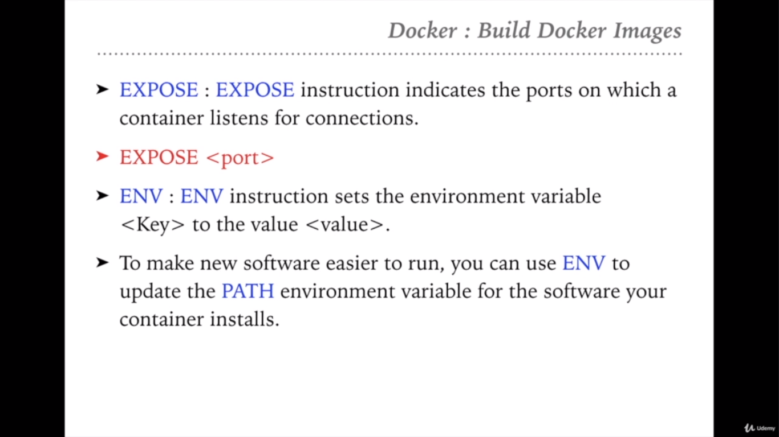

Slide 15
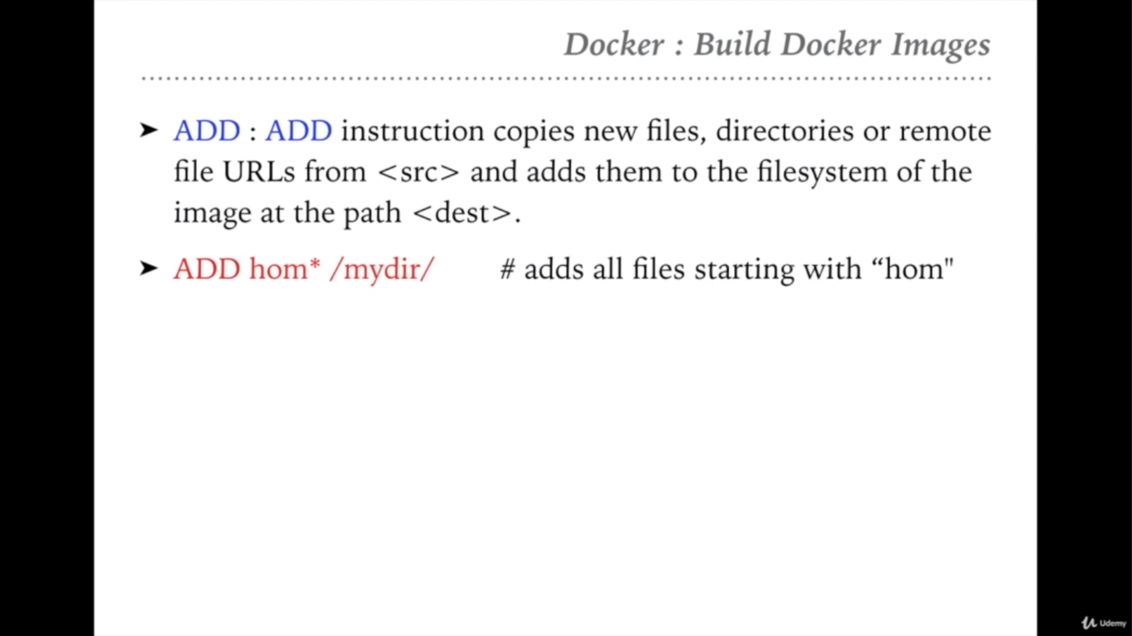

Slide 16
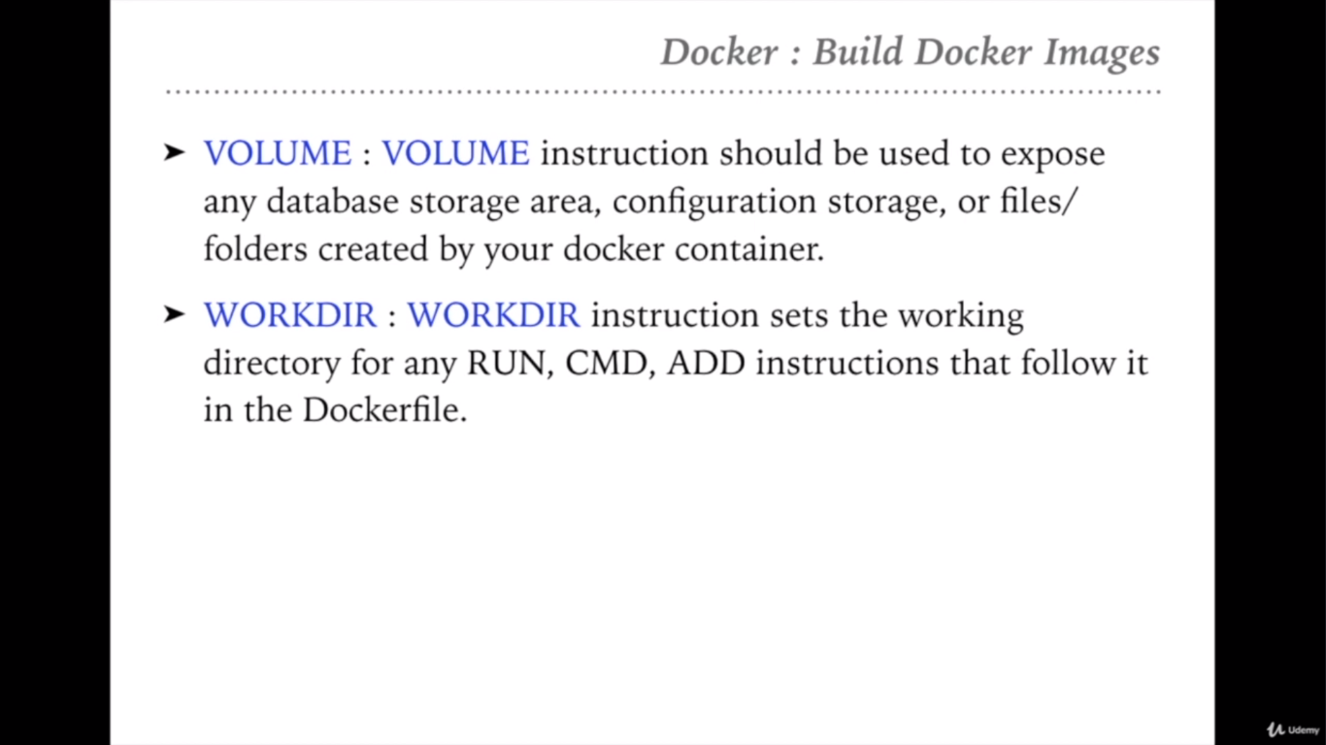

Slide 17


Slide 18
Project Jenkins File Content:
pipeline {
agent any
stages {
stage('Build Application') {
steps {
sh 'mvn -f pom.xml clean package'
}
post {
success {
echo "Now Archiving the Artifacts...."
archiveArtifacts artifacts: '**/*.war'
}
}
}
Stage('Create Tomcat Docker Image'){
steps {
sh "docker build . -t tomcatsamplewebapp:${env.BUILD_ID}"
}
}
}
}

Slide 19
Project's Dockerfile Content :
FROM tomcat:8.0
ADD **/*.war /usr/local/tomcat/webapps
EXPOSE 8080
CMD ["catalina.sh", "run"]

Slide 20


Slide 21
Troubleshooting: Build Docker Image
Maybe some users may get Permission error like:
Got permission denied while trying to connect to the Docker daemon socket at unix:///var/run/docker.sock: Post
Then, you need to follow the below commands:
1. Add Jenkins User in Docker Group
sudo usermod -a -G docker jenkins
2. Restart Your Jenkins
systemctl restart jenkins

Slide 22


Slide 23
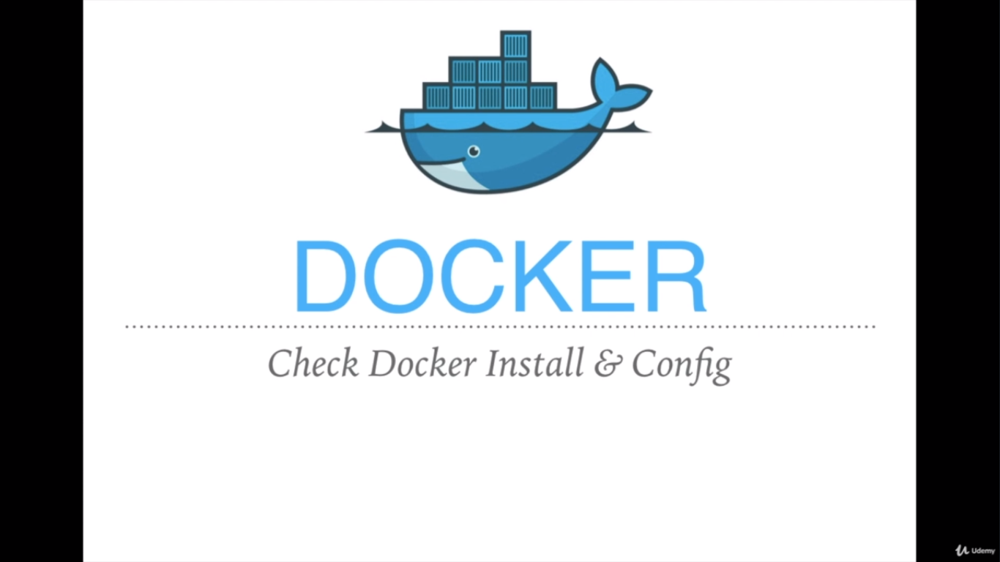

Slide 24
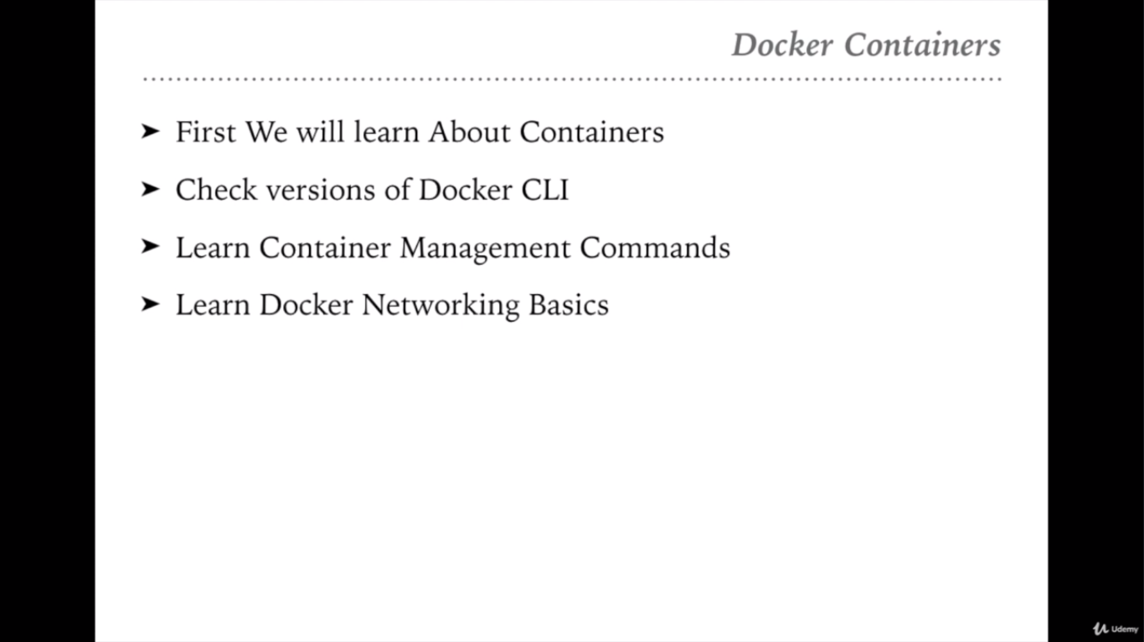

Slide 25
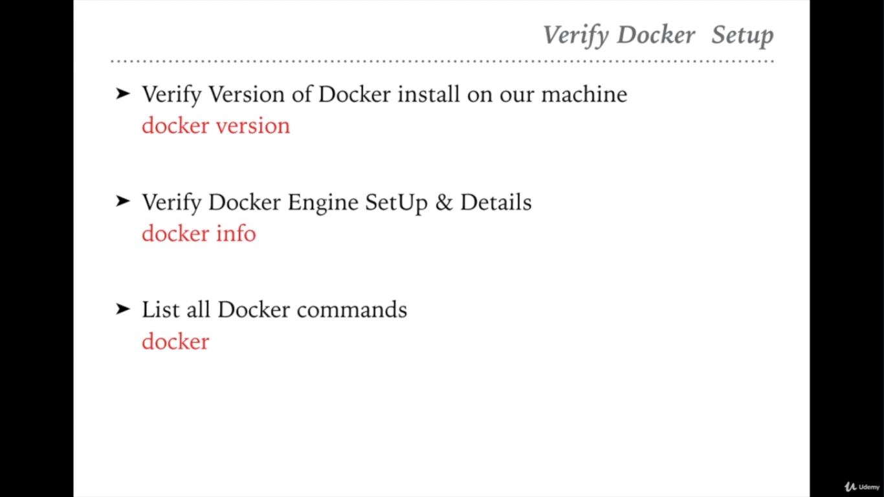
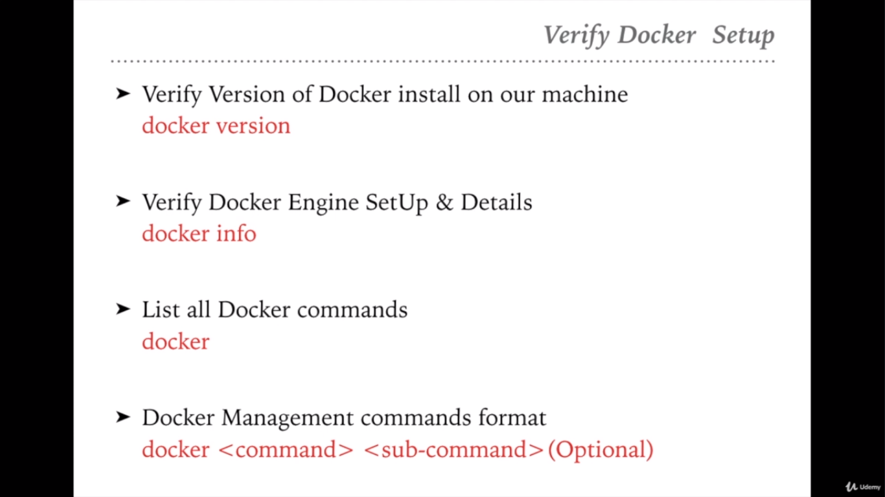

Slide 26
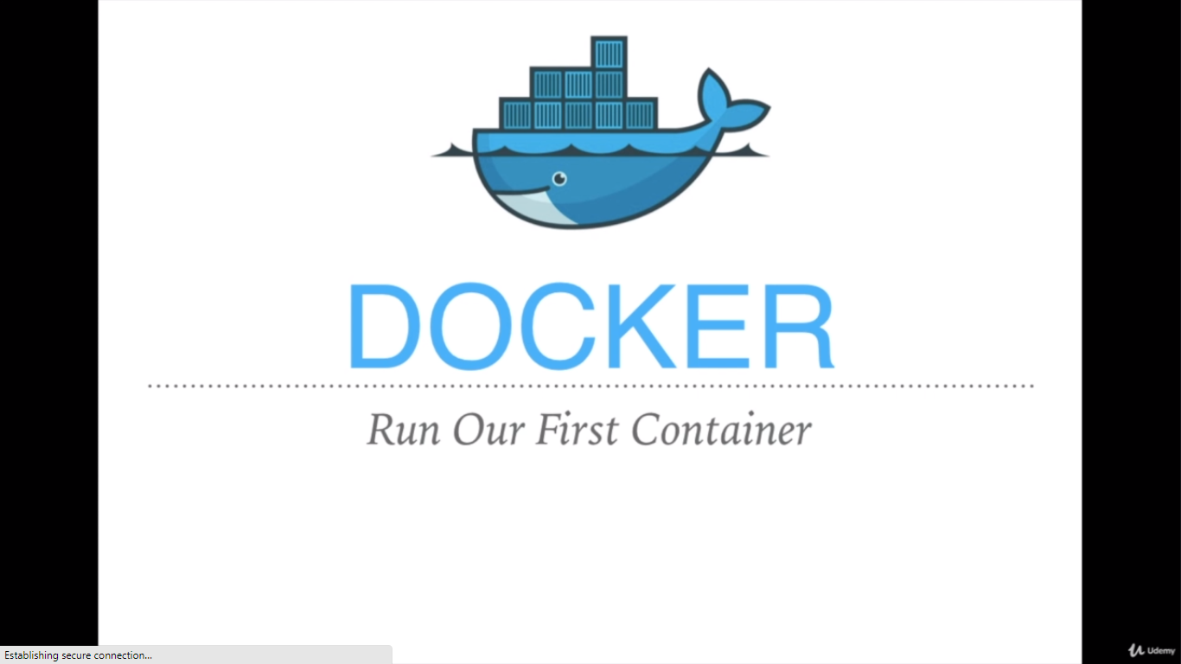

Slide 27
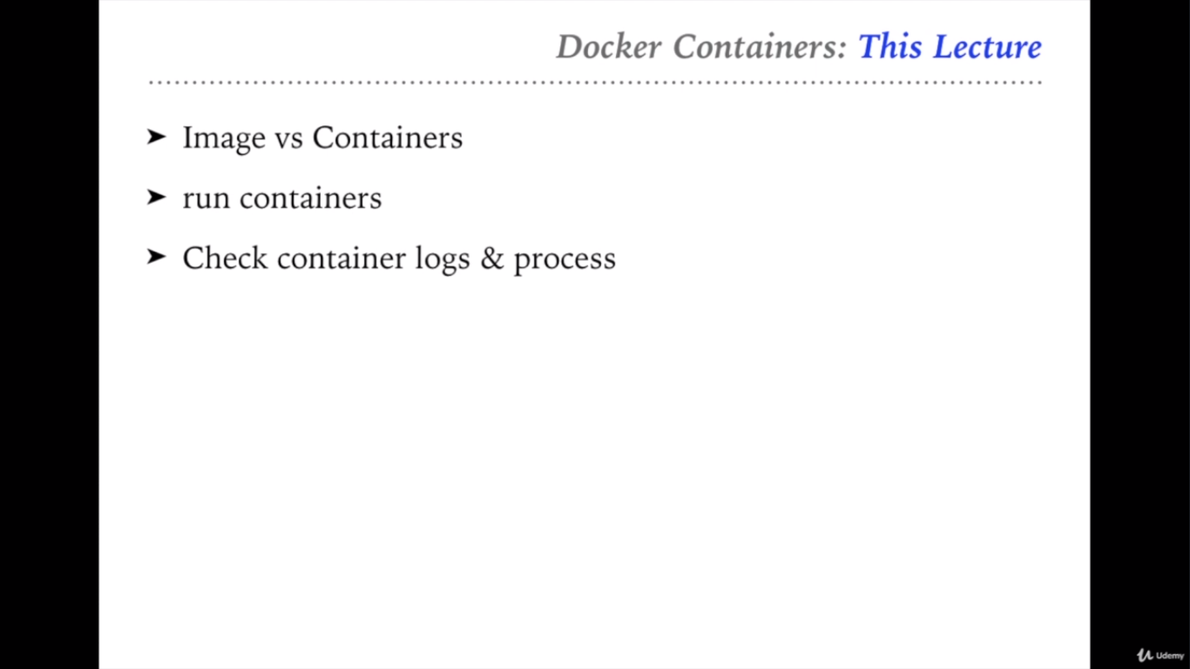

Slide 28
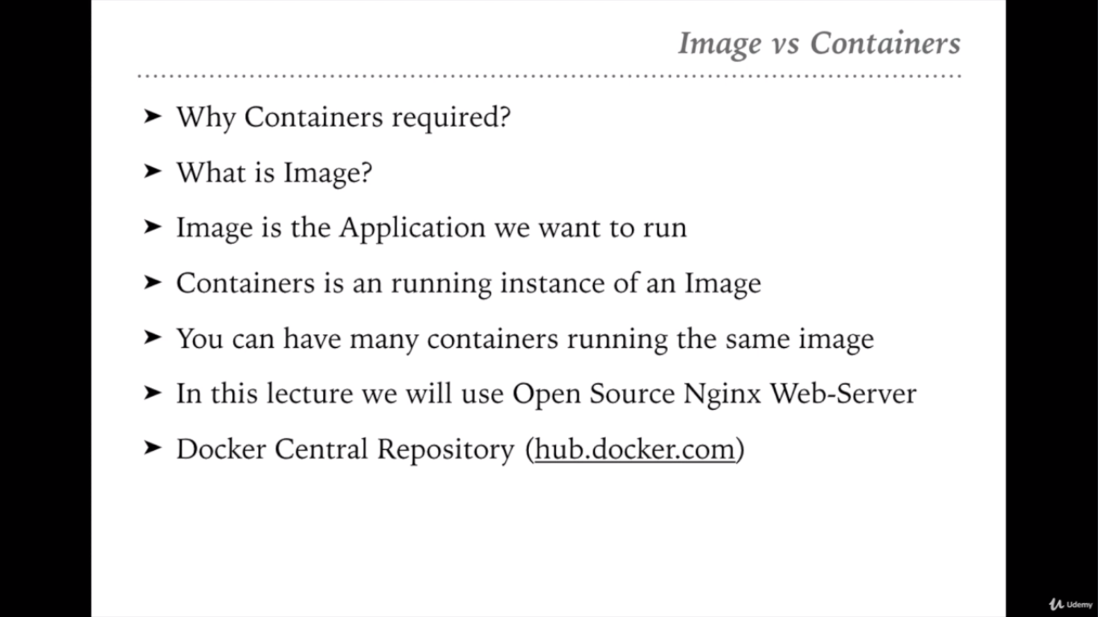

Slide 29
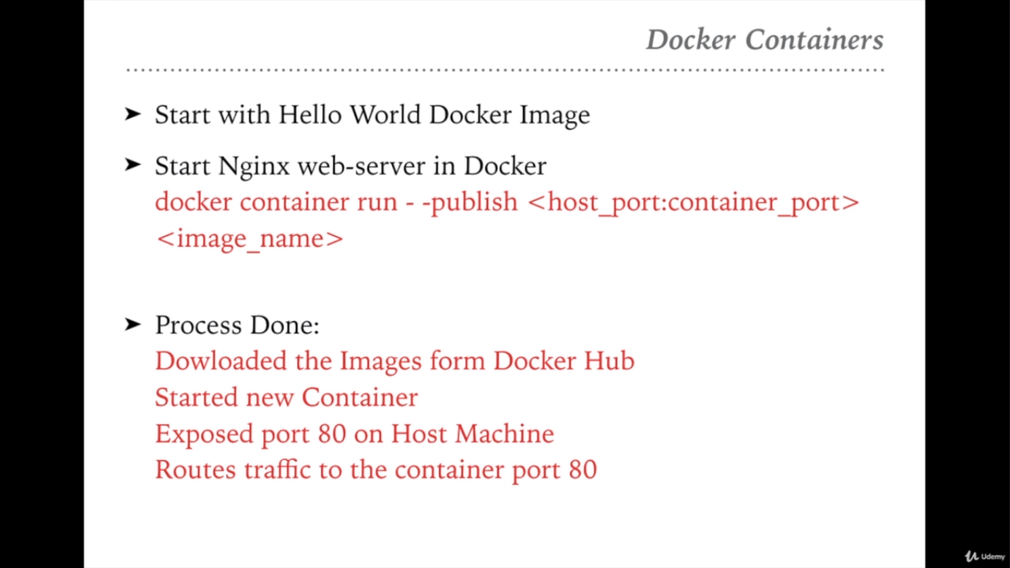

Slide 30


Slide 31
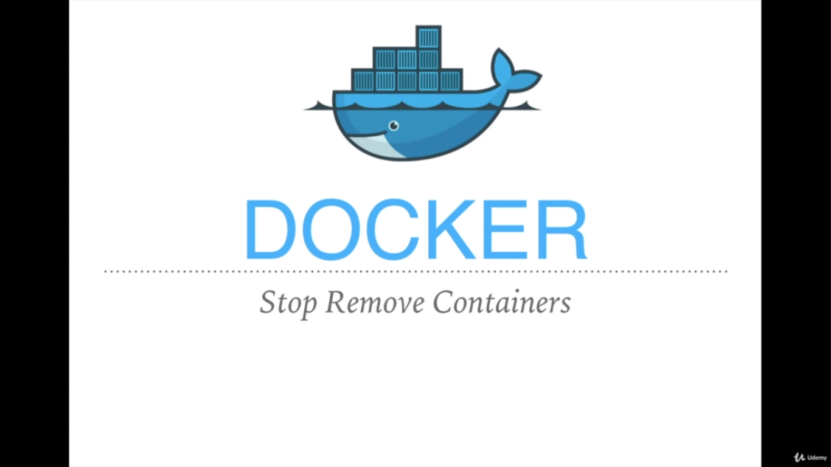

Slide 32
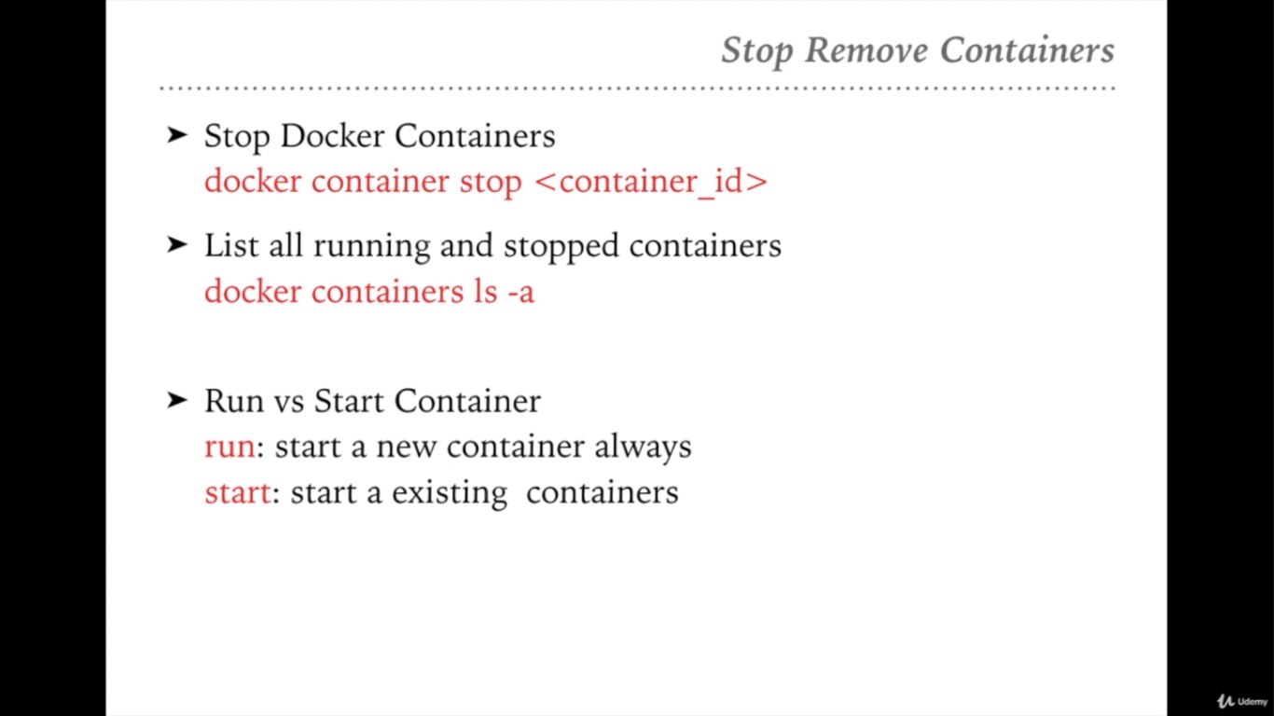

Slide 33
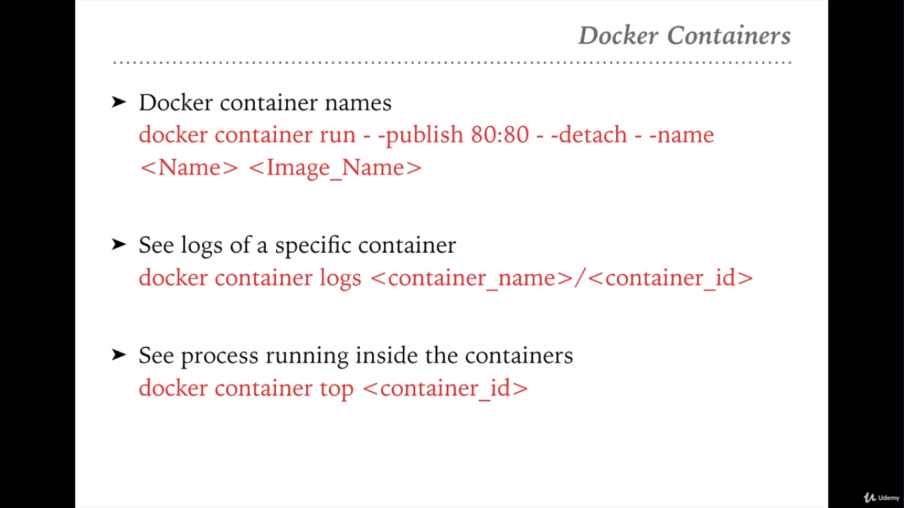

Slide 34


Slide 35
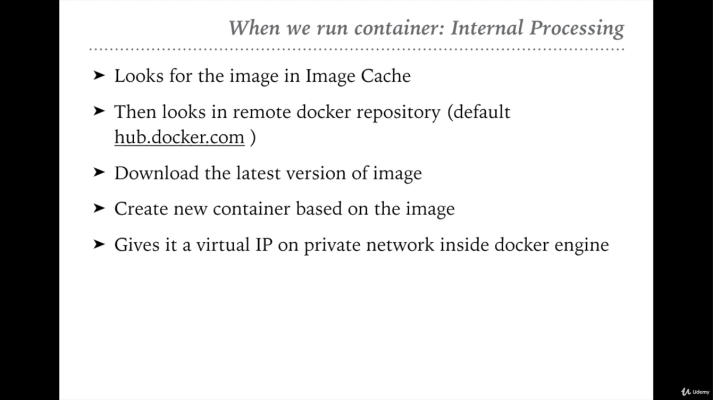
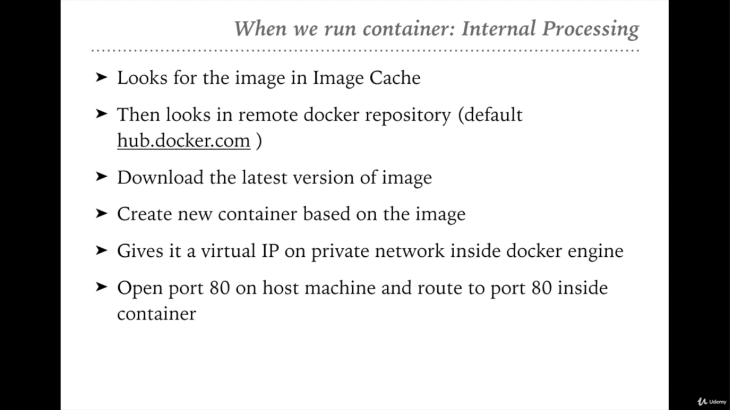
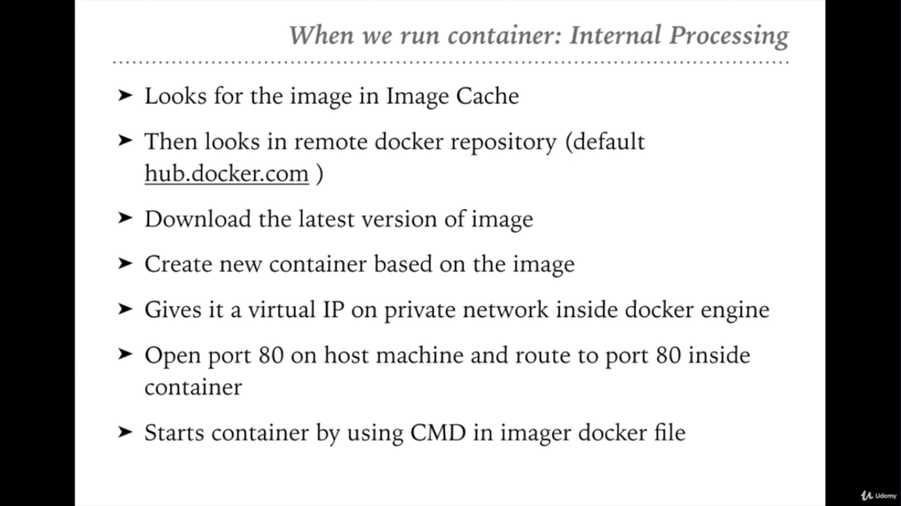

Slide 36
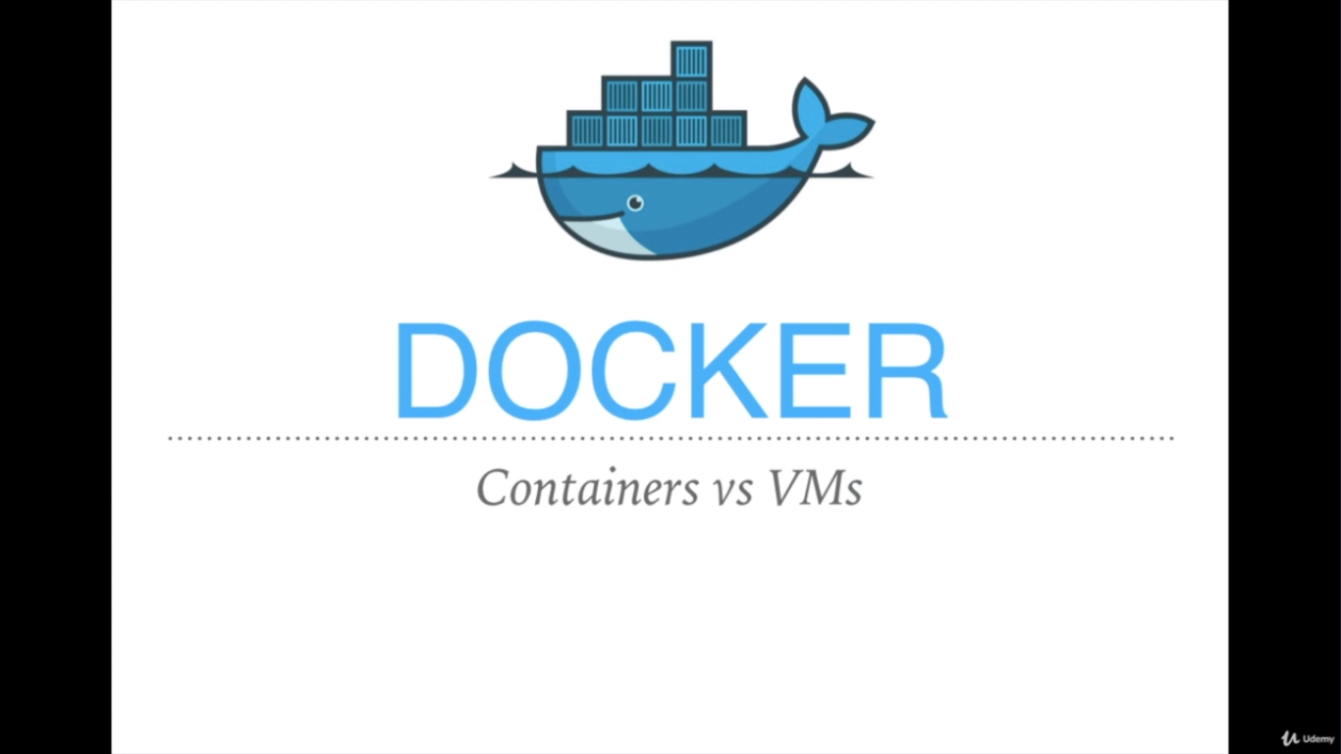

Slide 37
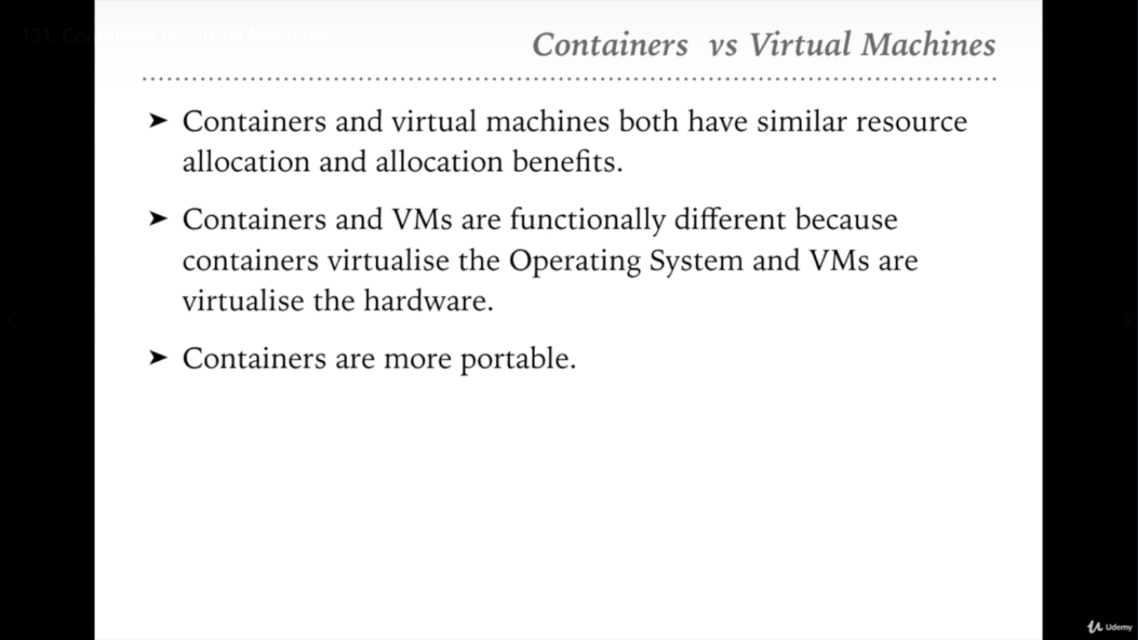

Slide 38
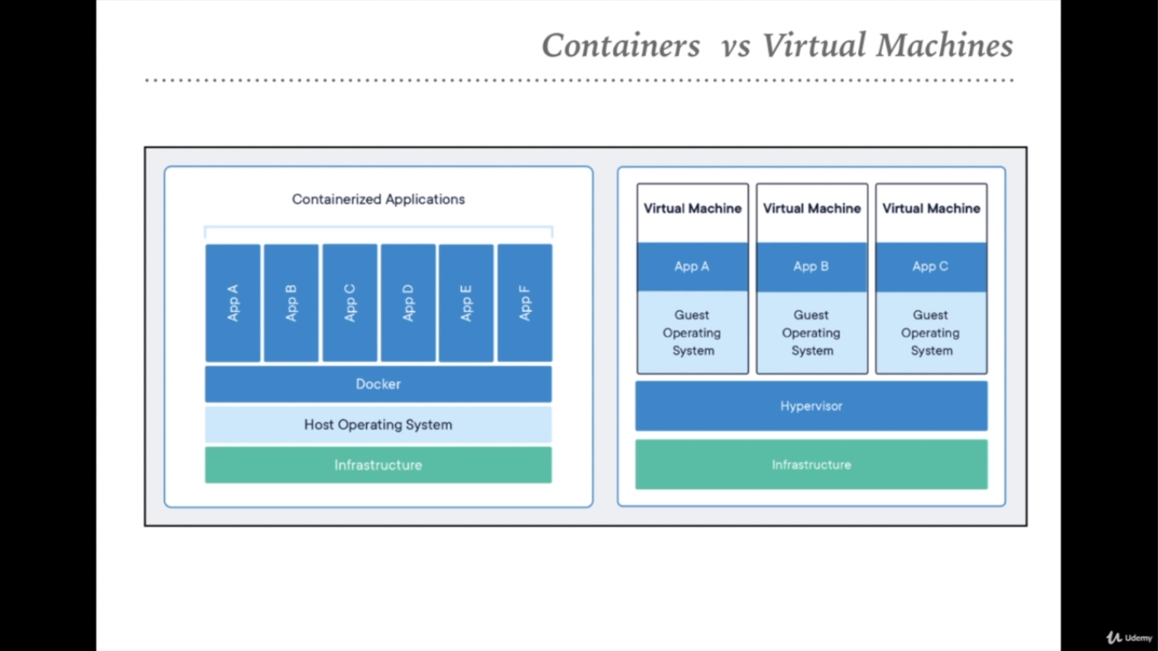

Slide 39
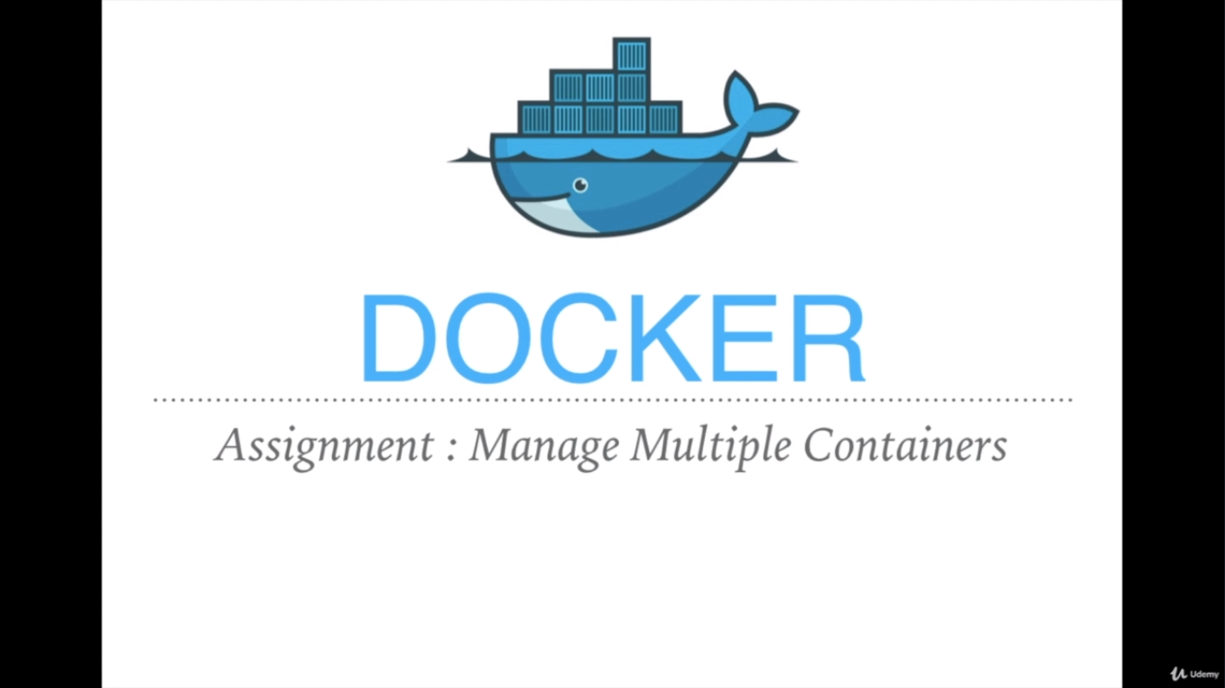

Slide 40
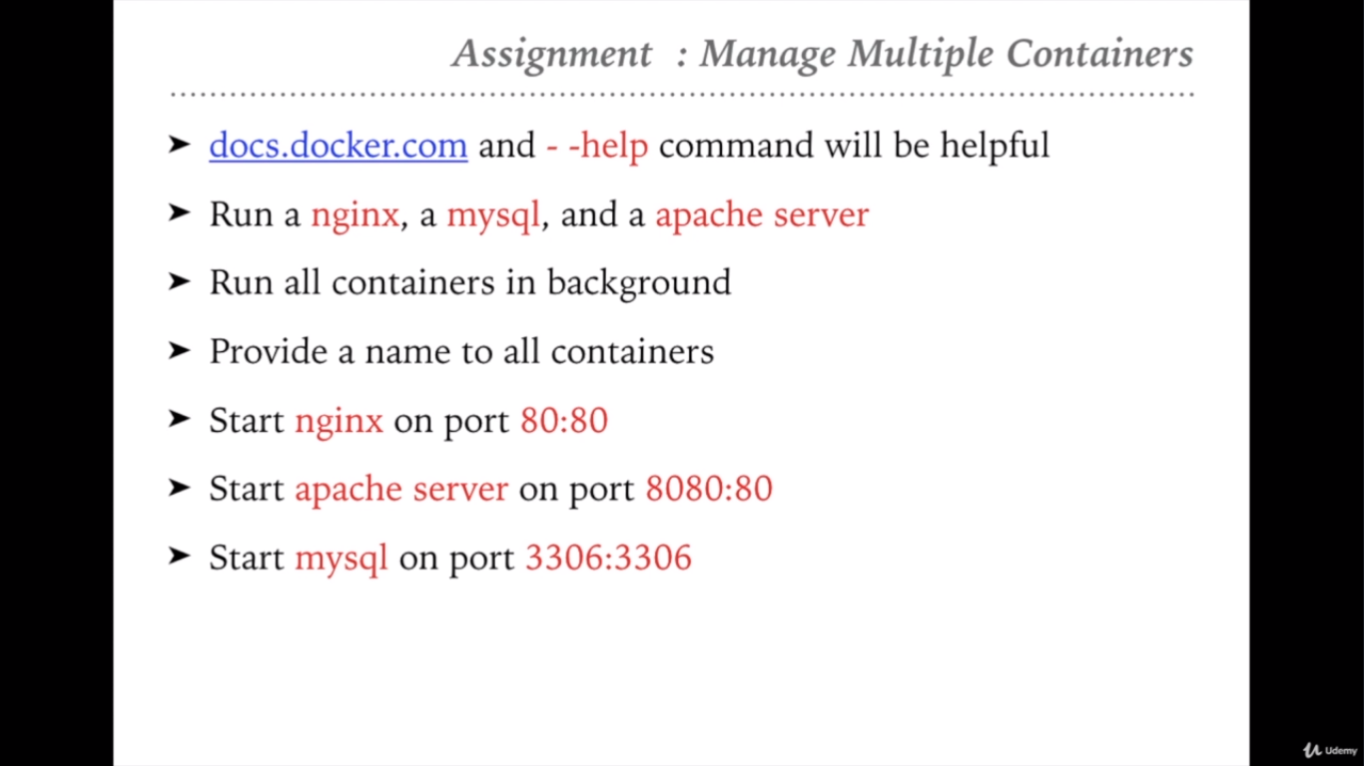

Slide 41
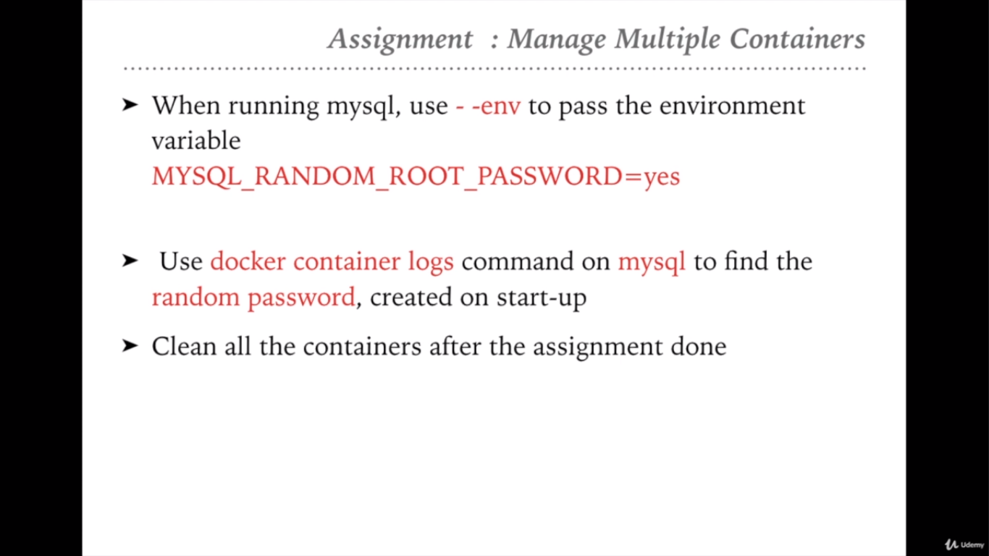

Slide 42
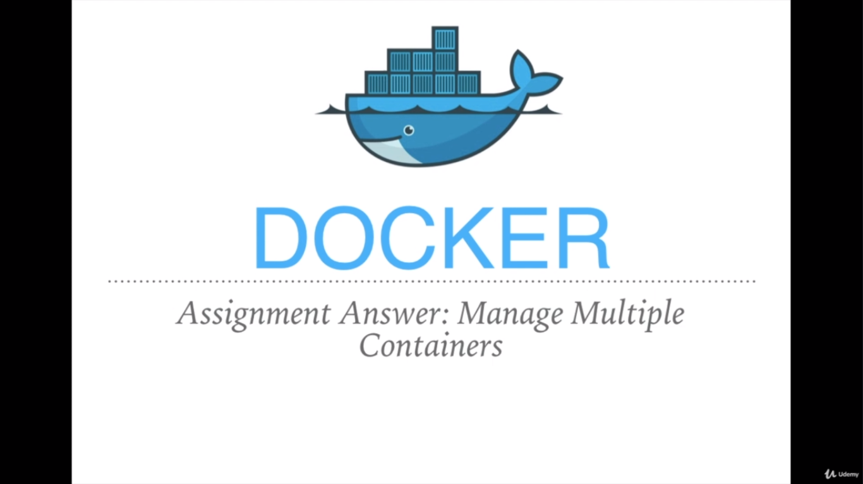

Slide 43
$docker container run -d -p 80:80 -name proxyserver nginx Using the command, which will Download, extract and execute the nginx image
$docker container run -d -p 8080:80 -name webserver httpd Using the command, which will Download, extract and execute the httpd (Apache Server) image
$docker container run -d -p 3306:3306 -name mysqldb --env MYSQL_RANDOM_ROOT_PASSWORD=yes mysql Using the command, which will Download, extract and execute the mysql image
$docker container logs mysqldb Using the command, which will display the logs for the mysqldb image
$docker stop proxyserver webserver mysql Using the command, which will stops the running images (proxyserver, webserver, mysql)
$docker container rm proxyserver webserver mysql Using the command, which will remove the containers (proxyserver, webserver, mysql)

Slide 44
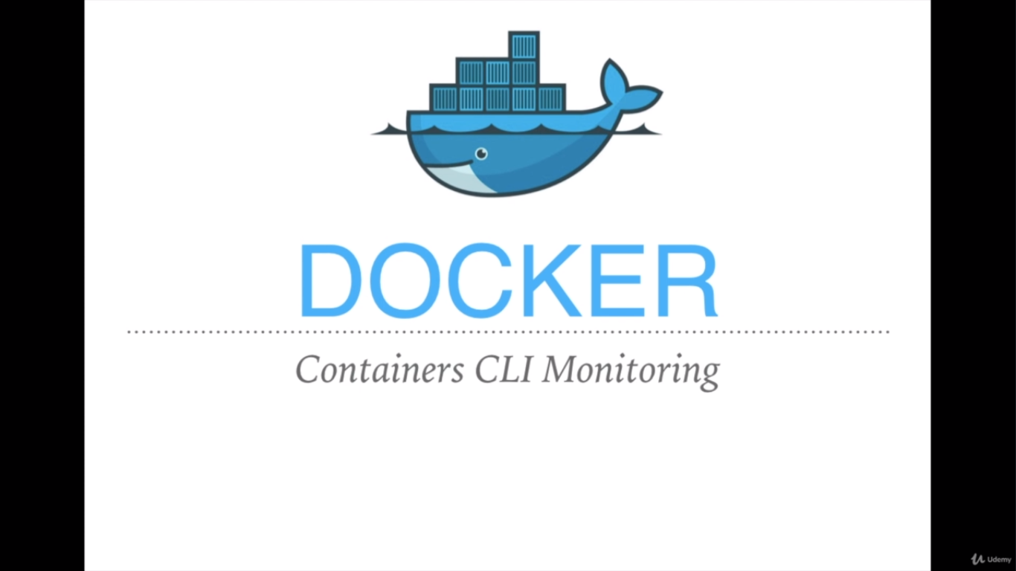

Slide 45
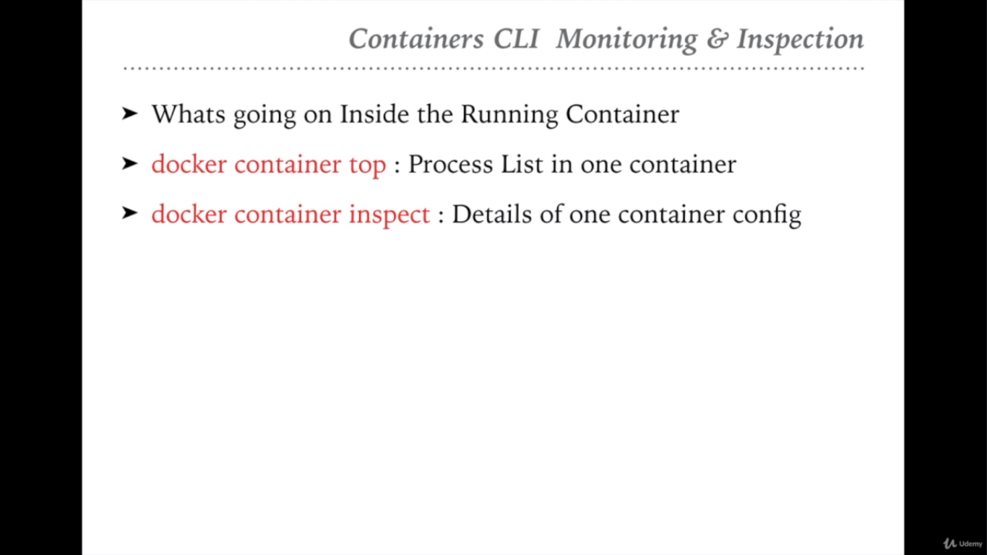
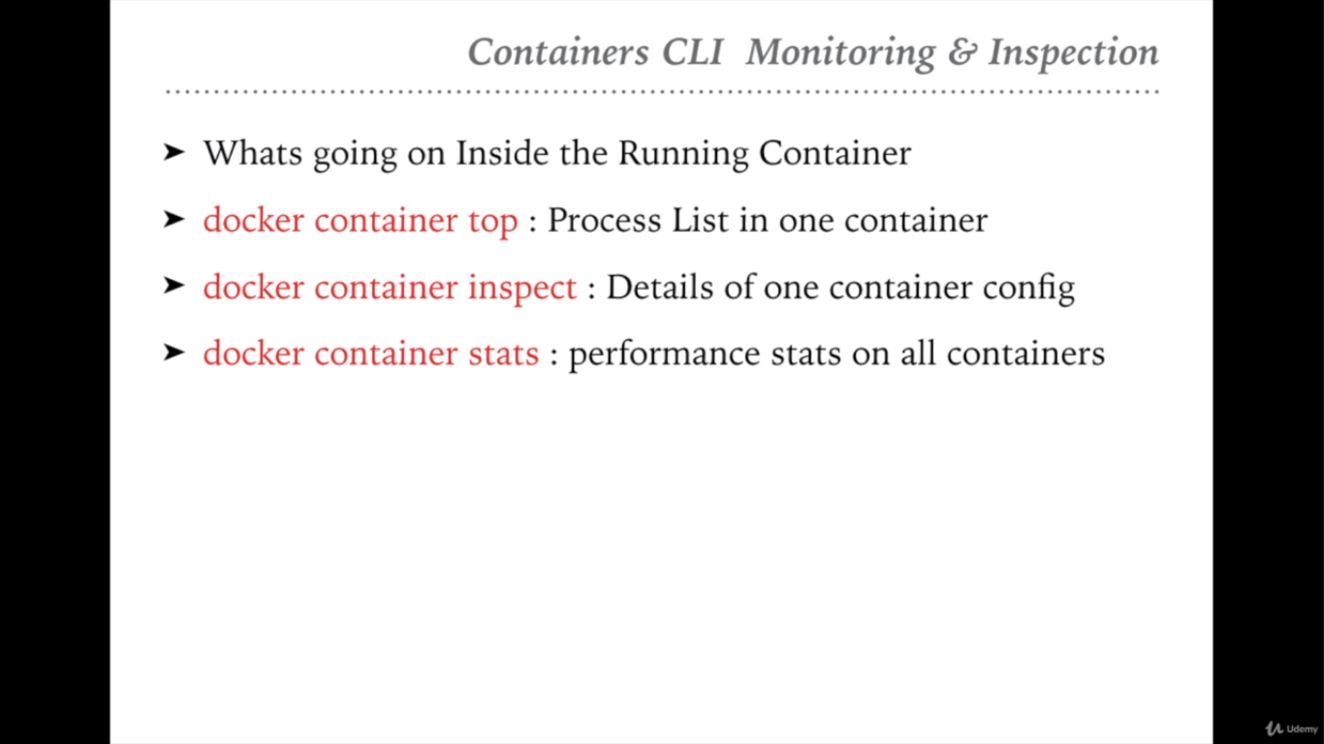

Slide 46
$docker container ps -- It displays all the running process
$docker container top <imageID> -- It displays all the list of processes of the container
$docker container inspect <imageID> -- It displays the configuration details of the container
$docker container stats <imageID> -- It displays the performance stats of the container

Slide 47
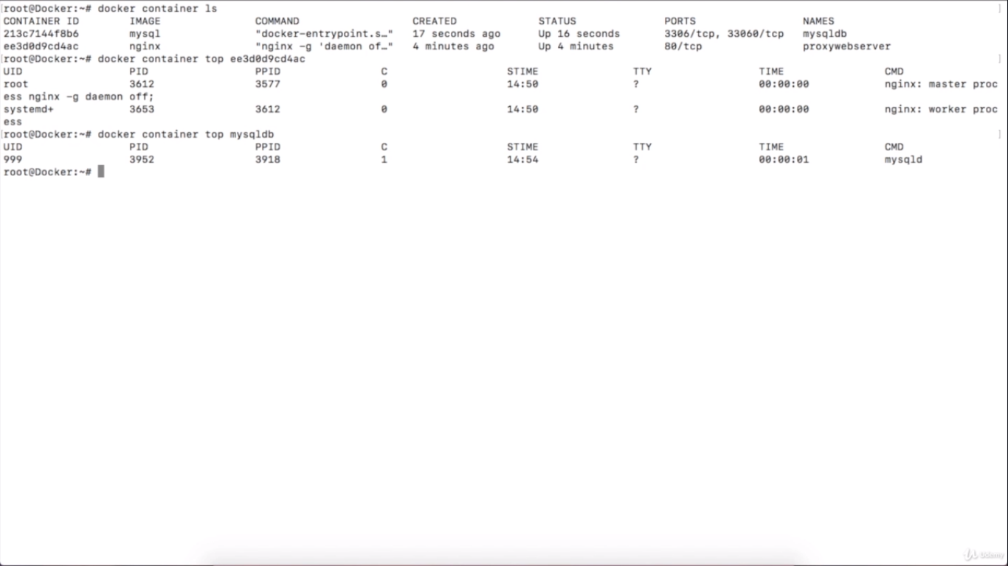

Slide 48


Slide 49
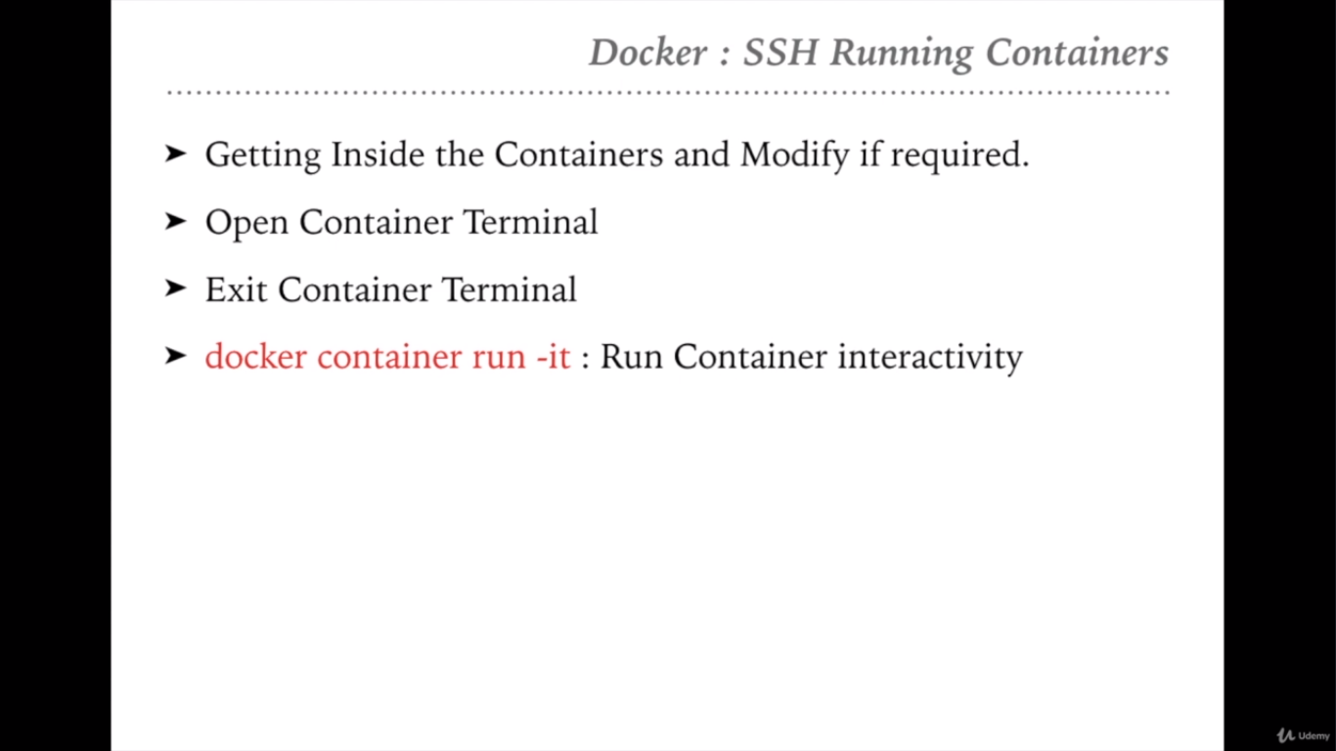

Slide 50
$docker container run -it --name <container_Name> <Image_name> bash
It will go inside the container where we can see all the files and folder which bundle for the respective container

Slide 51


Slide 52
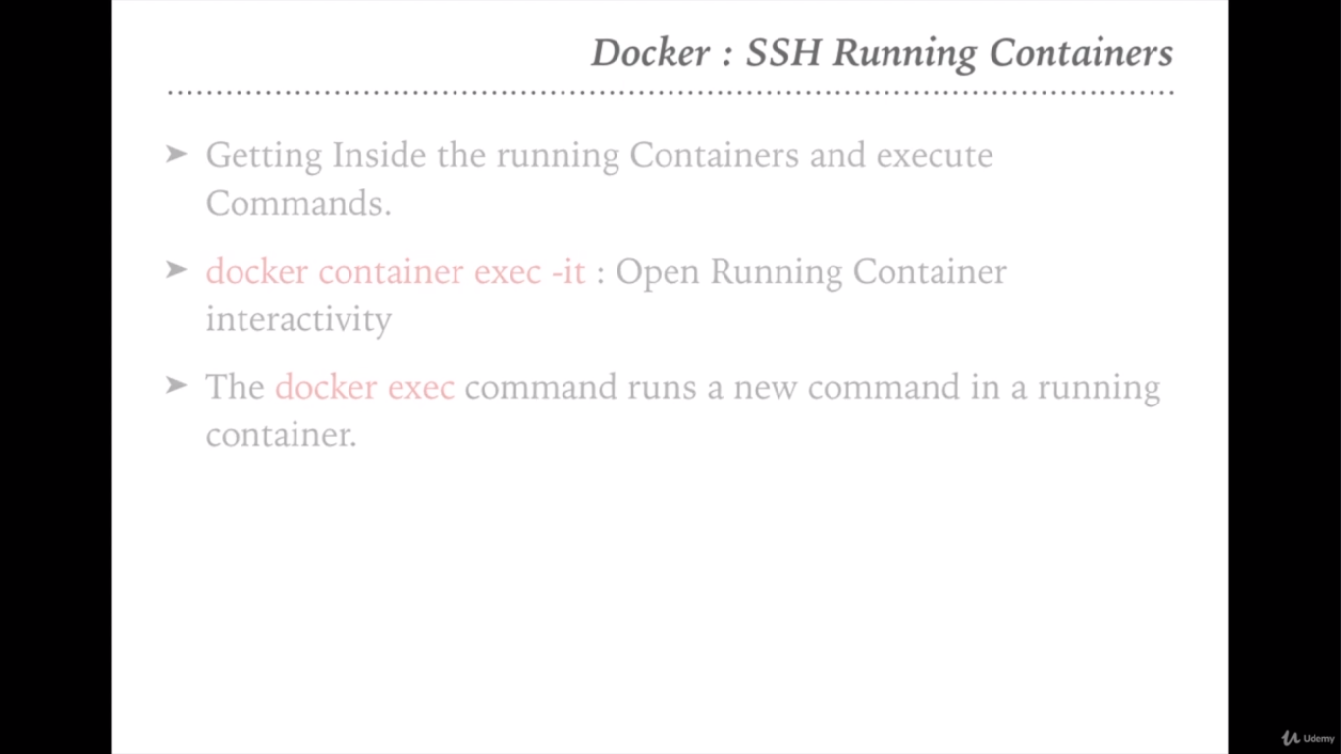
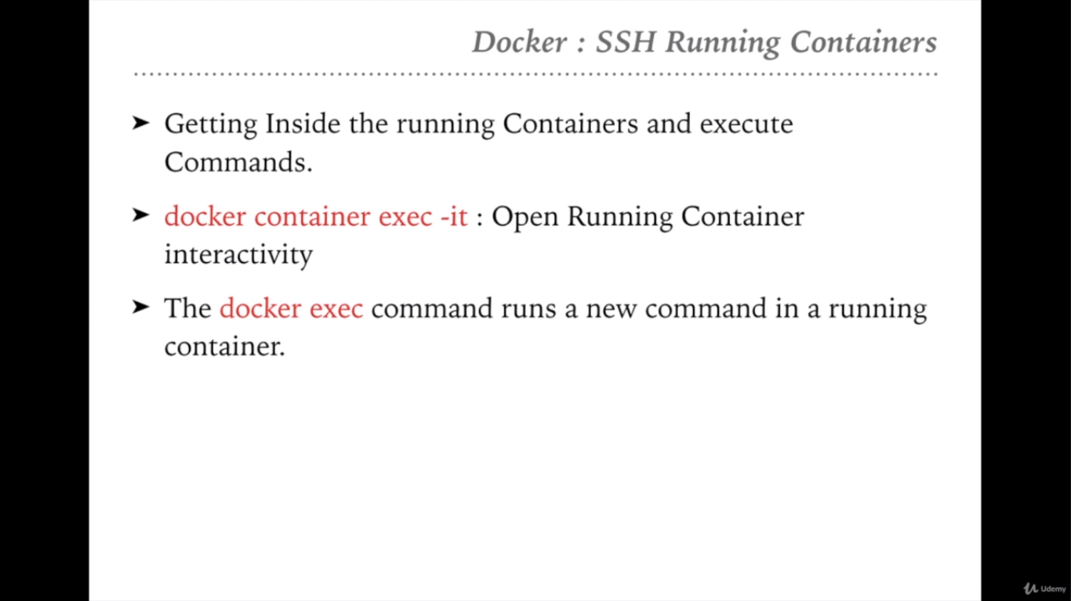

Slide 53
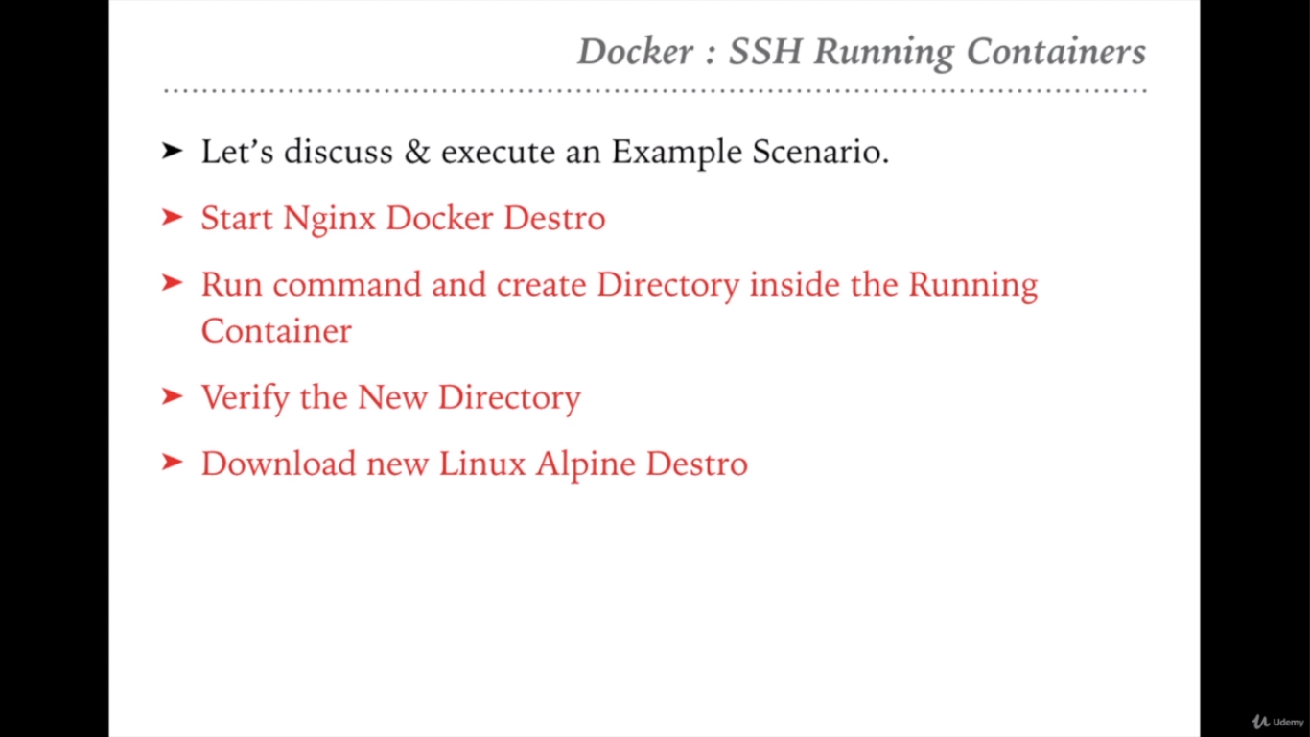
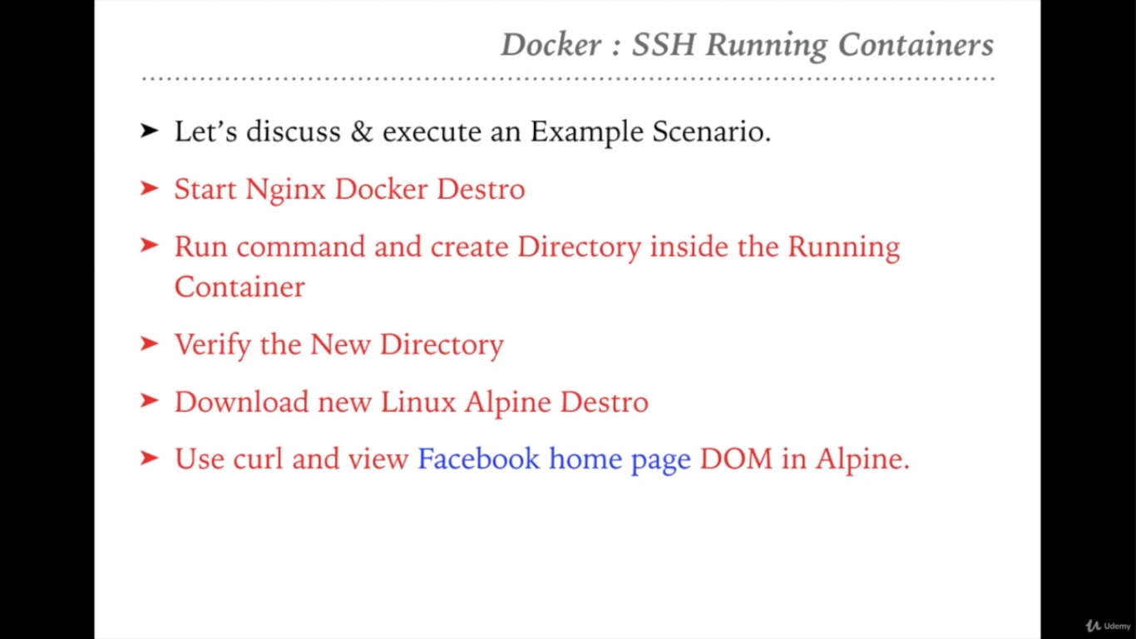

Slide 54
$docker container ps -- displays the running container
$docker container run -it --name ngnixweb nginx bash - It will run the container
$docker container exec -it 8e24c0a14090 touch /tmp/sample - It will create a directory inside the container <8e24c0a14090>
$docker container exec -it 8e24c0a14090 bash -- To go inside the container and check the dir created inside the tmp folder
$docker container run -it ubuntu bash -- Run the ubuntu container which will download, extract and execute the ubuntu container
$curl www.facebook.com - which displays as ‘bash: curl: command not found’
Update the packages by the command $apt-get update
Install the curl using the command $apt-get install curl
Execute the curl command now as $curl www.facebook.com

Slide 55


Slide 56
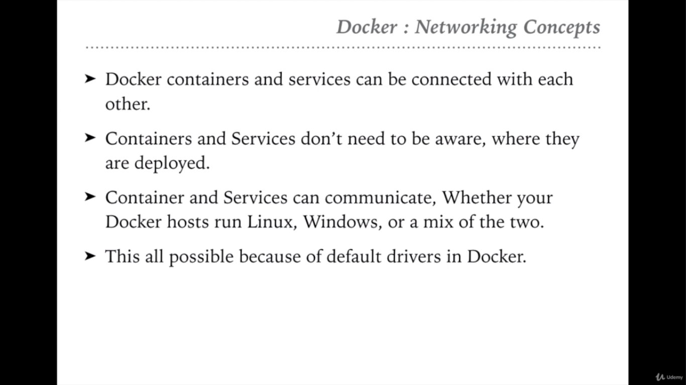

Slide 57
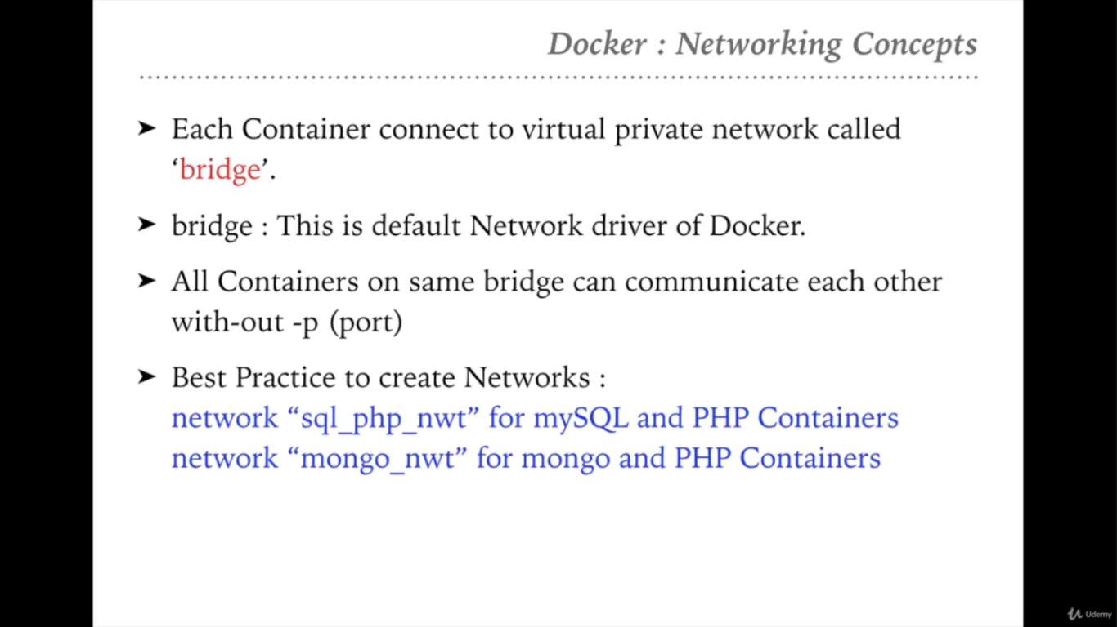

Slide 58
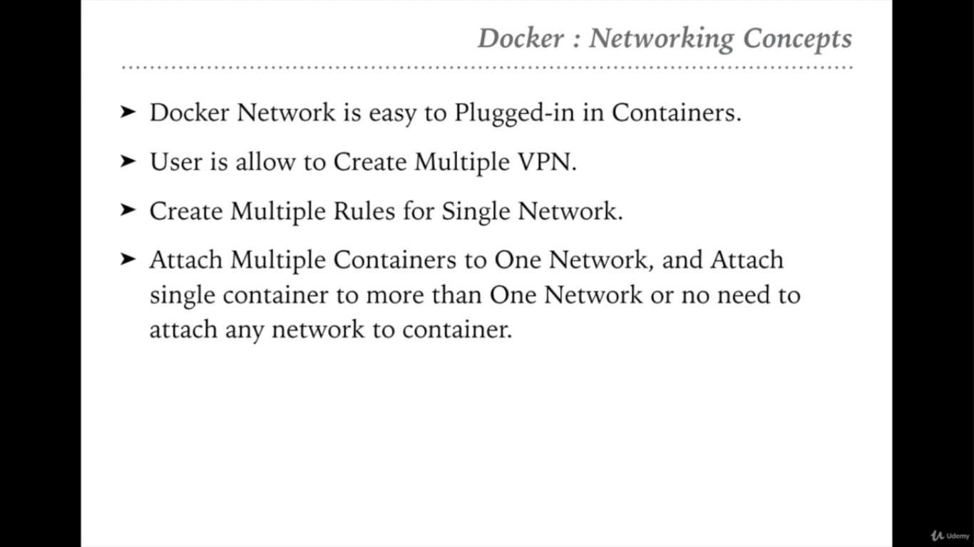

Slide 59


Slide 60
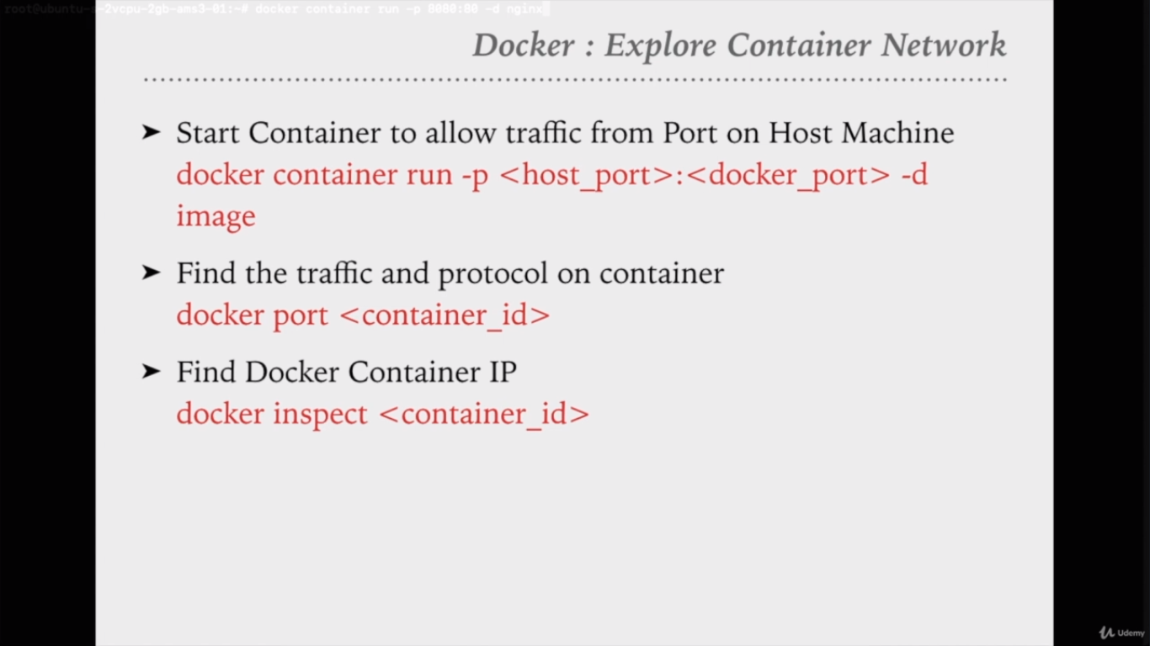
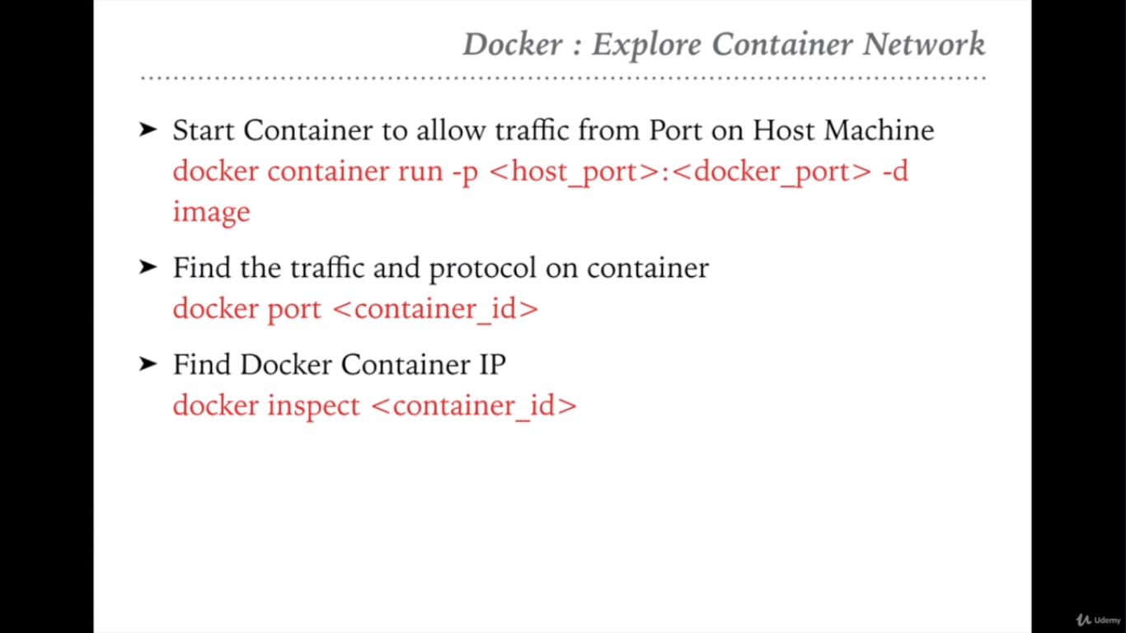

Slide 61
$docker container run -p 8080:80 -d <ContainerID> -- 8080 is the port for host machine where docker is installed and 80 is the port for docker running. Now try to access the application (For example: Ngnix container) with the port 8080 on host machine like http://localhost:8080 then you will get the nginx webpage
$docker container port <ContainerID> -- which gives the port binded for the container
$docker container inspect <ContainerID> -- which gives the entire config of the container
$docker container inspect --help -- It gives the list of attributes to inspect
$docker container inspect -f ‘{{.NetworkSettings.IPAddress}}’ <ContainerID> -- It gives the specific value of the attribute (NetworkSettings.IPAddress)

Slide 62


Slide 63


Slide 64


Slide 65
$docker network ls -- Shows all the network
$docker network ls -f driver=bridge -- It filters and displays the network where the attribute ‘driver’ matches with the values as ‘bridge’
$docker network ls --format “{{.ID}}:{{.Driver}}” -- It displays all the ID’s and Drivers

Slide 66


Slide 67
$docker network inspect <Network ID> -- It gives the entire information in a json format

Slide 68


Slide 69


Slide 70
$docker network create <user-defined-network-name> -- It creates new network
$docker network ls -- List all the networks
$docker network inspect <NetworkName> -- Gives the information of network
$docker container ls -- List all the containers
$docker container run --name my_nginx --network <user-defined-network-name> nginx -- it means nginx container running with user defined network
$docker network inspect <NetworkName>
$docker container inspect <networkName> -- Information of container
$docker network connect <user-defined-network-name> <container_name> -- User defined network connects to the specified container
$docker network disconnect bridge <container_name> -- Disconnects the network for the specified container

Slide 71


Slide 72


Slide 73


Slide 74
$docker container run -d --name my_nginx1 --network mynetwork nginx:alpine -- Running the container with the name as ‘my_nginx1’ and with network name as ‘mynetwork’
$docker container run -d --name my_nginx2 --network mynetwork nginx:alpine -- Same as above
$docker network inspect mynetwork -- Prints the information
$docker container exec -it my_nginx1 ping my_nginx2 -- Pinging the my_nginx2 from my_nginx1.
$docker container stop my_nginx1 -- Stops the my_nginx1 container
$docker container run -d --name my_nginx3 --network mynetwork nginx:alpine -- Running the container with the name as ‘my_nginx3’
Overall, docker uses the static IP’s. So once we stops the container then the static IP might be assign if we start any other container. That’s why, docker uses the DNS concept instead of IP address. We will use the container names in place of IP’s since IP’s static and can be change.

Slide 75


Slide 76
Concepts:
Complete concept of docker images
Build docker images
Deploy docker images
Docker images management
Docker Hub Central Repository
Manage Local images

Slide 77


Slide 78


Slide 79


Slide 80


Slide 81


Slide 82



Slide 83


Slide 84


Slide 85


Slide 86


Slide 87


Slide 88


Slide 89


Slide 90


Slide 91


Slide 92


Slide 93


Slide 94


Slide 95


Slide 96


Slide 97


Slide 98


Slide 99


Slide 100


Slide 101


Slide 102


Slide 103


Slide 104


Slide 105


Slide 106


Slide 107


Slide 108



Slide 109


Slide 110


Slide 111


Slide 112


Slide 113


Slide 114


Slide 115


Slide 116


Slide 117


Slide 118


Slide 119


Slide 120

my-script.py file

Slide 121
# To push the image into dockerub then we need to start the image build using the dockerhub acount name as below
$docker image build -t vijay2533/python_custom:0.0.1 /root/
# Now, to push the image to the dockerhub then we have to login to dockerhub using the command $docker login and then enter the details of the account
# Command to push the images into dockerhub is $docker push vijay2533/python_custom:0.0.1
# Image will be available in the local then can be remove the image using the command $docker image rm vijay2533/python_custom:0.0.1
# Image is not available in the local which is in dockerhub now, which means publicly anyone access our image like below
$docker container run vijay2533/python_custom:0.0.1

Slide 122


Slide 123


Slide 124


Slide 125


Slide 126


Slide 127


Slide 128


Slide 129


Slide 130


Slide 131


Slide 132


Slide 133


Slide 134


Slide 135
In the above slide, $pwd and /apps paths are mounted which means $pwd is the path of the container and /apps path of the host machine(non docker file system). It will be useful for the developer to change in the config, that can be place into the /apps path which will be automatically reflect into the $pwd path of docker container.
This is how, configs can be reflect into the running container
$docker volume inspect <imageName> which shows the mounted points of the image

Slide 136


Slide 137


Slide 138


Slide 139


Slide 140


Slide 141


Slide 142


Slide 143


Slide 144


Slide 145


Slide 146


Slide 147

Docker-compose.yml file

Slide 148


Slide 149


Slide 150


Slide 151


Slide 152
Link for docker-compose command :
https://www.linode.com/docs/guides/how-to-use-docker-compose/

